Slide 2
Exploring your career potential with Prosper

Slide 3
Session objectives
Recognise the scope of your skills and competencies - and how these are transferable.
Consider how you can develop your own definition of career success.
Explore the concept of Ikigai.
Appreciate how Prosper resources might support you to explore career pathways tailored to their own values, skills and needs.
Notes:
So, what are the objectives of today’s session?
Making use of exercises from Prosper’s Portal we are going to:
*Read slides*
Throughout the session, there are about 3 exercises, which you’ll complete independently so have a pen, paper or blank word document if you want.
I’d love to hear from you, so please do come off mute or use the chat to share your thoughts and reflections.

Slide 4
Prosper Overview
Notes:
Before we jump into that, I’ll take just a couple of minutes to explain what Prosper is.
While I’m doing this, you might want to register online – SHARE LINK

Slide 5
What is Prosper?
Prosper is an innovative approach to researcher career development that seeks to unlock potential to thrive across multiple career pathways – both within and beyond academia.
Prosper is used by 70+ HEIs across the UK and beyond. Tried and tested, its model and associated online Portal is freely available to whole sector.
"What Prosper has built is very impressive, and the impact it has had on postdoctoral researchers in its pilot phase is extremely promising. I believe Prosper can play a leading role in driving best practice in developing postdoctoral research careers and strongly encourage research institutions across the UK to adopt and make use of Prosper resources."
– Professor Dame Jessica Corner
Executive Chair, Research England
Notes:
Prosper is an approach to researcher career development, with the aim to unlock potential to thrive in whatever career path they choose, whether in academia or beyond it. Though developed specifically for postdocs, the Portal and resources are now being used to support other groups of research staff and students.
Following a successful pilot period at the University of Liverpool, Manchester and Lancaster, UKRI are now funding Prosper’s roll-out to HEIs throughout the UK.

Slide 6
Prosper for postdocs and PGRs:
Reflect – identify skills, build confidence, discover career priorities
Explore – career paths and employer insights across 12 career clusters
Act – practical skills for continuous development
Community – resources to support peer-to-peer development
"Prior to Prosper I felt so lost in my career. Unsure what to do next and not having the confidence to take the next step or any sense of what that step might be. Prosper equipped me with the knowledge and tools I needed to change direction and to aim higher in my job search."
– Dr Zohra Butt,
former life sciences postdoc
Notes:
The Prosper Portal is where those users can find wealth of information, tools and resources to support their career development.
Reflect, Explore and Act are the pillars and the model – and the Portal (which I’m hoping you are on now) has three sections with these titles.
Reflect is all about self-reflection, and on identifying your skills and values together with what you like and dislike to do and work on and thinking about what makes you happy in your life.
Explore is about lifting your gaze, expanding your knowledge of what is out there. And you can do so through exploring the 12 career cluster and the employers insights.
Act is about providing practical guidance on how you can make the next step on your journey with confidence.

Slide 7
Defining career success
Notes:
Jumping in now to the main content of today’s session – starting by reflecting on career success.

Slide 8
Question - what does career success look like for you?
Notes:
I’ll open with a very big question…what does career success look like to you? Write down, first thing that comes into your head. I’ll just give you a minute or two for this, no more. I want it to be quite instinctive. Feel free to share them in the chat!
Ok, now look again at your definition of success, and ask yourself, what is it based on? Maybe some based your definition on a linear path to academic success; maybe some based on becoming a leader, in a field beyond academia; maybe some based on having a balance between your professional life and your home life. But how much of who you are is really shaping this definition?

Slide 9
What does career success look like for you?
“Success is liking yourself, liking what you do, and liking how you do it.”​
Maya Angelou
Notes:
I personally like this quote from Maya Angelou, who wrote in one of her essays *read quote*.
Granted this is about success more broadly, but one thing strikes me about this – if your definition of success is not personal to you, then you will never achieve what Maya defines here.
So how do we create our own picture of success? This is what we will make a start on today.

Slide 10
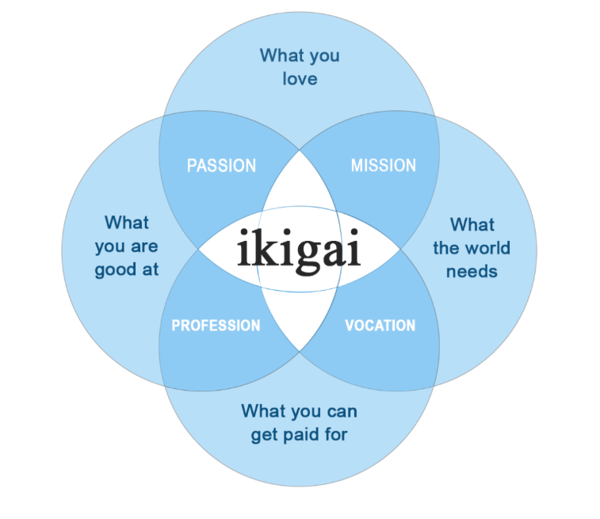
Japanese concept of Ikigai
Notes:
One well recognized tool/concept is Ikigai - a Japanese concept that refers to a sense of purpose, meaning, and fulfillment in life. The word "ikigai" roughly translates to "a reason for being." It originates from in the Japanese island of Okinawa, where people are known for their longevity and happiness.
The idea behind ikigai is that everyone has a unique purpose or calling in life and finding that purpose can bring a deep sense of satisfaction and contentment. It is believed that ikigai arises from the intersection of four elements:
What you love (your passion)
What you are good at (your profession or skill)
What the world needs (your mission)
What you can be paid for (your vocation or job)
When these four elements come together, it can enrich one's life. The pursuit of ikigai involves self-reflection, exploration, and a willingness to take risks and make changes in life to align with one's purpose
What are the model’s flaws? A little idealistic to imagine you will find an exact sweet spot where all of these factors meet in the middle, but in thinking about it, I find, you do realise where you might be a little more willing to flex.

Slide 11
Reflection:
Take 10 minutes to start thinking about your own Ikigai.
Jot down some ideas reflecting on:
What you love
What the world needs
What you’re good at
What you can get paid for
Note – this won’t be enough time to do this properly! There’s a detailed guide to completing your Ikigai, including prompt questions on this page:
Personal job satisfaction - Prosper
Notes:
I'm going to give 10 minutes for you to individually start thinking about your own ikigai. It won’t be long enough to do properly, just a starting point: Personal job satisfaction – Prosper
Ok, when you’re done – I’d love to know how you found this? Which sections were easiest or most difficult?

Slide 12
Zooming in on ‘What you’re good at’
Guess what…it is more than ‘just’ your research!
Notes:
Now, given that today we want to think about your skills in more detail, I’m going to use Ikigai again to start this conversation – because we’re going to zoom in on the ‘what you are good at section for the next exercise’
I’m going to hazard a guess that a fair few of you put ‘research’ or something very closely linked to your research in what you’re good at?
While that may be true, in order to really explore your full range of career options, you need to start seeing your transferable skills in full colour.

Slide 13
Transferable skills
Transferable skills are skills you can use in any job. These skills are often called portable skills because you can bring what you’ve learned from one job to another. You can apply these general skills to various fields, working environments, and industries.”
Quote from Forage - Transferable Skills: Definition, Examples, and How to Build Yours in 2025 - Forage
Notes:
Transferable Skills: Definition, Examples, and How to Build Yours in 2025 - Forage

Slide 14
Identifying your transferable skills - activity
You’ll need a pen and paper/blank word document to make some notes.
Note down one of your research outputs (be specific).
Underneath this output, list all of the technical or specialist research skills that research output required.
List all of the ‘other’ skills (besides the specialist ones) you used to achieve this output.
List any attributes/behaviours you have developed to achieve this output.
This is the first section of an activity which you can continue with in your time if you wish:
https://prosper.liverpool.ac.uk/learning-development-clusters/skills-identification/
Notes:
In this next activity, the aim is for you to appreciate how the skills you are developing through your research are transferable.
*Read the slide*
Allow 10/15 minutes
https://prosper.liverpool.ac.uk/learning-development-clusters/skills-identification/

Slide 15
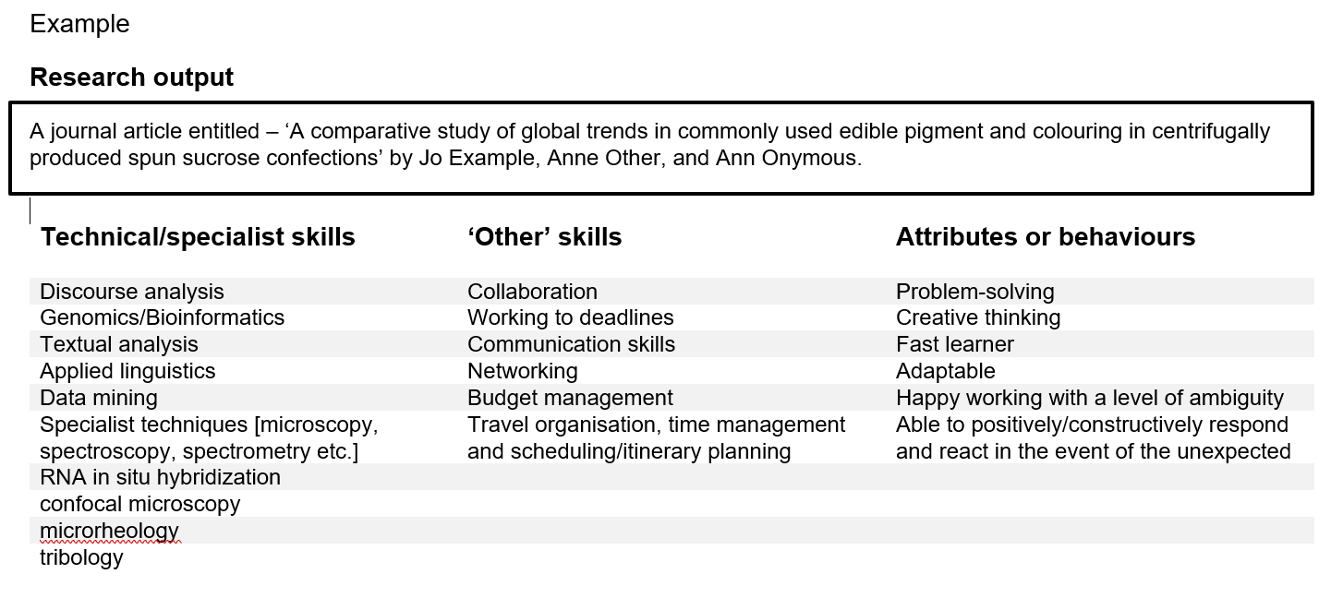
Notes:
I’ll leave this on screen as an example
When time is up:
How was that?
Did anybody identify ‘other’ skills/attributes/behaviours they had not recognized before?
If you found that helpful, I’d encourage you to look at the other exercises on this page: https://prosper.liverpool.ac.uk/learning-development-clusters/skills-identification/ to build a stronger picture of your transferable skills.

Slide 16

Where can your transferable skills take you?
Linear career path is not the only path to career success!
The concept of squiggly careers normalises the fact that people develop their careers in different directions.
For an example of where knowing your skills might lead, read this case study from Prosper cohort member: Dr Devon Crouch - Prosper
Notes:
So, we’ve talked about how to identify what you want in a career, what you’re good at – but where can that take you? I’ll point out some resources shortly to help you explore this independently, but first – some inspiration.
Your skills open doors for you – but they are not always the obvious ones. A Linear career path is not the only way to career success! Sometimes sideways moves may lead you to an industry where you progress more quickly or find greater fulfilment.
The concept of ‘squiggly careers’ is a nice one as it normalises the fact that careers can take twists and turns, but that doesn’t mean that they are derailed. The term “Squiggly Careers” was coined by Helen Tupper and Sarah Ellis, the founders of Amazing If, a UK-based career development company – Taryn if you could put the link to the squiggly careers toolkit in the chat. A squiggly career is about growth through exploration, skill development, and personal fulfillment — not just promotions or job titles. It reflects how today’s professionals adapt to change, pursue varied interests, and redefine success throughout their working lives.
As a last activity, I wanted to show a real example of a researcher who developed aa greater understanding of his skills through Prosper, which led to unexpected opportunities.
Taryn, could you share the link to Dr Devon Crouch – Prosper case study please?

Slide 17
Please share your reflections on the case study in the chat.
Any quote/part in particular which resonates with you? Anything which surprises you?
One lesson or action you might take from Devon’s story?
Notes:
As you’re reading through, ask yourself (and share in the chat) – is there anything which resonates with you? Surprises you? One lesson/action you might take from Devon’s story?

Slide 18
Exploring career pathways with Prosper – resources
If I had to choose three to recommend as a starting point…
Define your values – Prosper
Career clusters – Prosper
Personal branding - Prosper
Notes:
Finally, we have only started to scratch the surface today – the Prosper Portal is full of resources to support you further. If I had to pick three to advise as a starting point:
Define your values – Prosper
Career clusters – Prosper
Personal branding - Prosper

