Slide 2





Networking bingo
Dr Stefania Silvestri
Researcher Developer,
Researcher Development and Culture team
Led by
Supported by
An Academy project
Notes:
Welcome everyone to today’s session: Networking bingo. The session title is self-explanatory: we will work on networking today, I’ll get you to have a little hopefully fun activity, and end the session with some pizza!

Slide 3

Agenda
Networking strategies
Networking rules
Networking bingo
Final tips
Notes:
This is our agenda for today. We will talk about networking strategies or what you might want to consider when approaching networking. We will then set some ground rules for networking. Following this, and this will be the lengthiest part of the session, we will practice networking through a speed dating type of activity. Finally, we will collect some final tips that hopefully you can take away and reflect on.

Slide 4

Networking strategies
Notes:
So let’s talk about networking strategies. There is a lot of information and there is a wealth of resources on networking that you can use when trying to learn the art of connection with others. Networking in person and online is of course very different, and will require you to use different skills at time. But approaching any type of networking opportunity with a strategy is a good starting point to hopefully have an enjoyable and fruitful experience.

Slide 5
Networking strategies
Define your networking goals
Ask for help and offer value
Work on your personal branding
Follow up and keep your contact warm
Be patient and don't get discouraged
Notes:
On the screen you’ll see a list of networking strategies. When approaching a networking opportunity, having some strategies that you have already reflected on can increase the likelihood of having a more positive experience.
Start with defining your goals: what do you want to achieve through the networking? Do you want to make X contacts? Do you want to meet potential collaborators?
Remember that you bring a value into the conversation: you bring expertise, you have your own connections to put on the table, you can support others’ work. Similarly, you should be ready to ask for help: the more specific you can be, the more likely you are to obtain what you are looking for. For example, you could ask to be introduced to the someone in a more senior position.
Before starting your networking think about your personal branding: do not just state your name and job game, consider what type of information you want to convey (what are the most important things about your role for example) and what language you use to communicate them (avoid jargon for example, you don’t know if you are talking to someone in your exact same field or not!)
If you have made a positive connection, remember to keep that contact warm. Follow up at a later date, a couple of weeks for example, with an email. Share some information you had discussed in your first conversation (a paper you mentioned) and suggest a further contact, such as a meeting or a chat over a coffee.
Remember to be patient: you might not get successful contacts at the first go, or a follow-up opportunity might not come to fruition, and that is discouraging, but it is a numbers game, so it is worth being persistent.

Slide 6

Networking rules
Notes:
Following from the strategies, it is worth keeping in mind some brief rules. These apply to all networking opportunities, but especially in this session for the practical activity you are about to take part in.

Slide 7
Networking rules
Be open
Be a good listener
Engage in discussion
Exchange contact information if you find potential collaborators
Notes:
Be open, so be ready to answer questions. You can keep it professional; you don’t need to share personal information if you do not wish to.
But at the same be a good listener, don’t just pretend you are. Listen and ask follow-up questions.
Have a lively positive discussion, don’t make it a monologue
And if the three points above have gone well, remember to exchange contact information!

Slide 8

Networking bingo
Notes:
And now it’s time for your networking activity.

Slide 9
Networking bingo
10 minutes
Talk to as many people as possible
Fill out your bingo card
First to finish (get a line) gets a prize
Notes:
You have on screen some guidance.
You’ll have 10 minutes to talk to as many people as possible
The aim is of course to fill out your bingo card
The first to finish a line gets a price
Facilitator: timings can be adapted depending on audience size

Slide 10

Pizza and networking time
Action
Continue the conversations
that you started during the activity
Or continue filling out your bingo card
Notes:
I hope you enjoyed the networking bingo. Before finishing the session, I’d like to encourage you to continue the conversations you started today, maybe even use the time you have now over pizza to continue talking to others in the room and fill out your card!

Slide 11

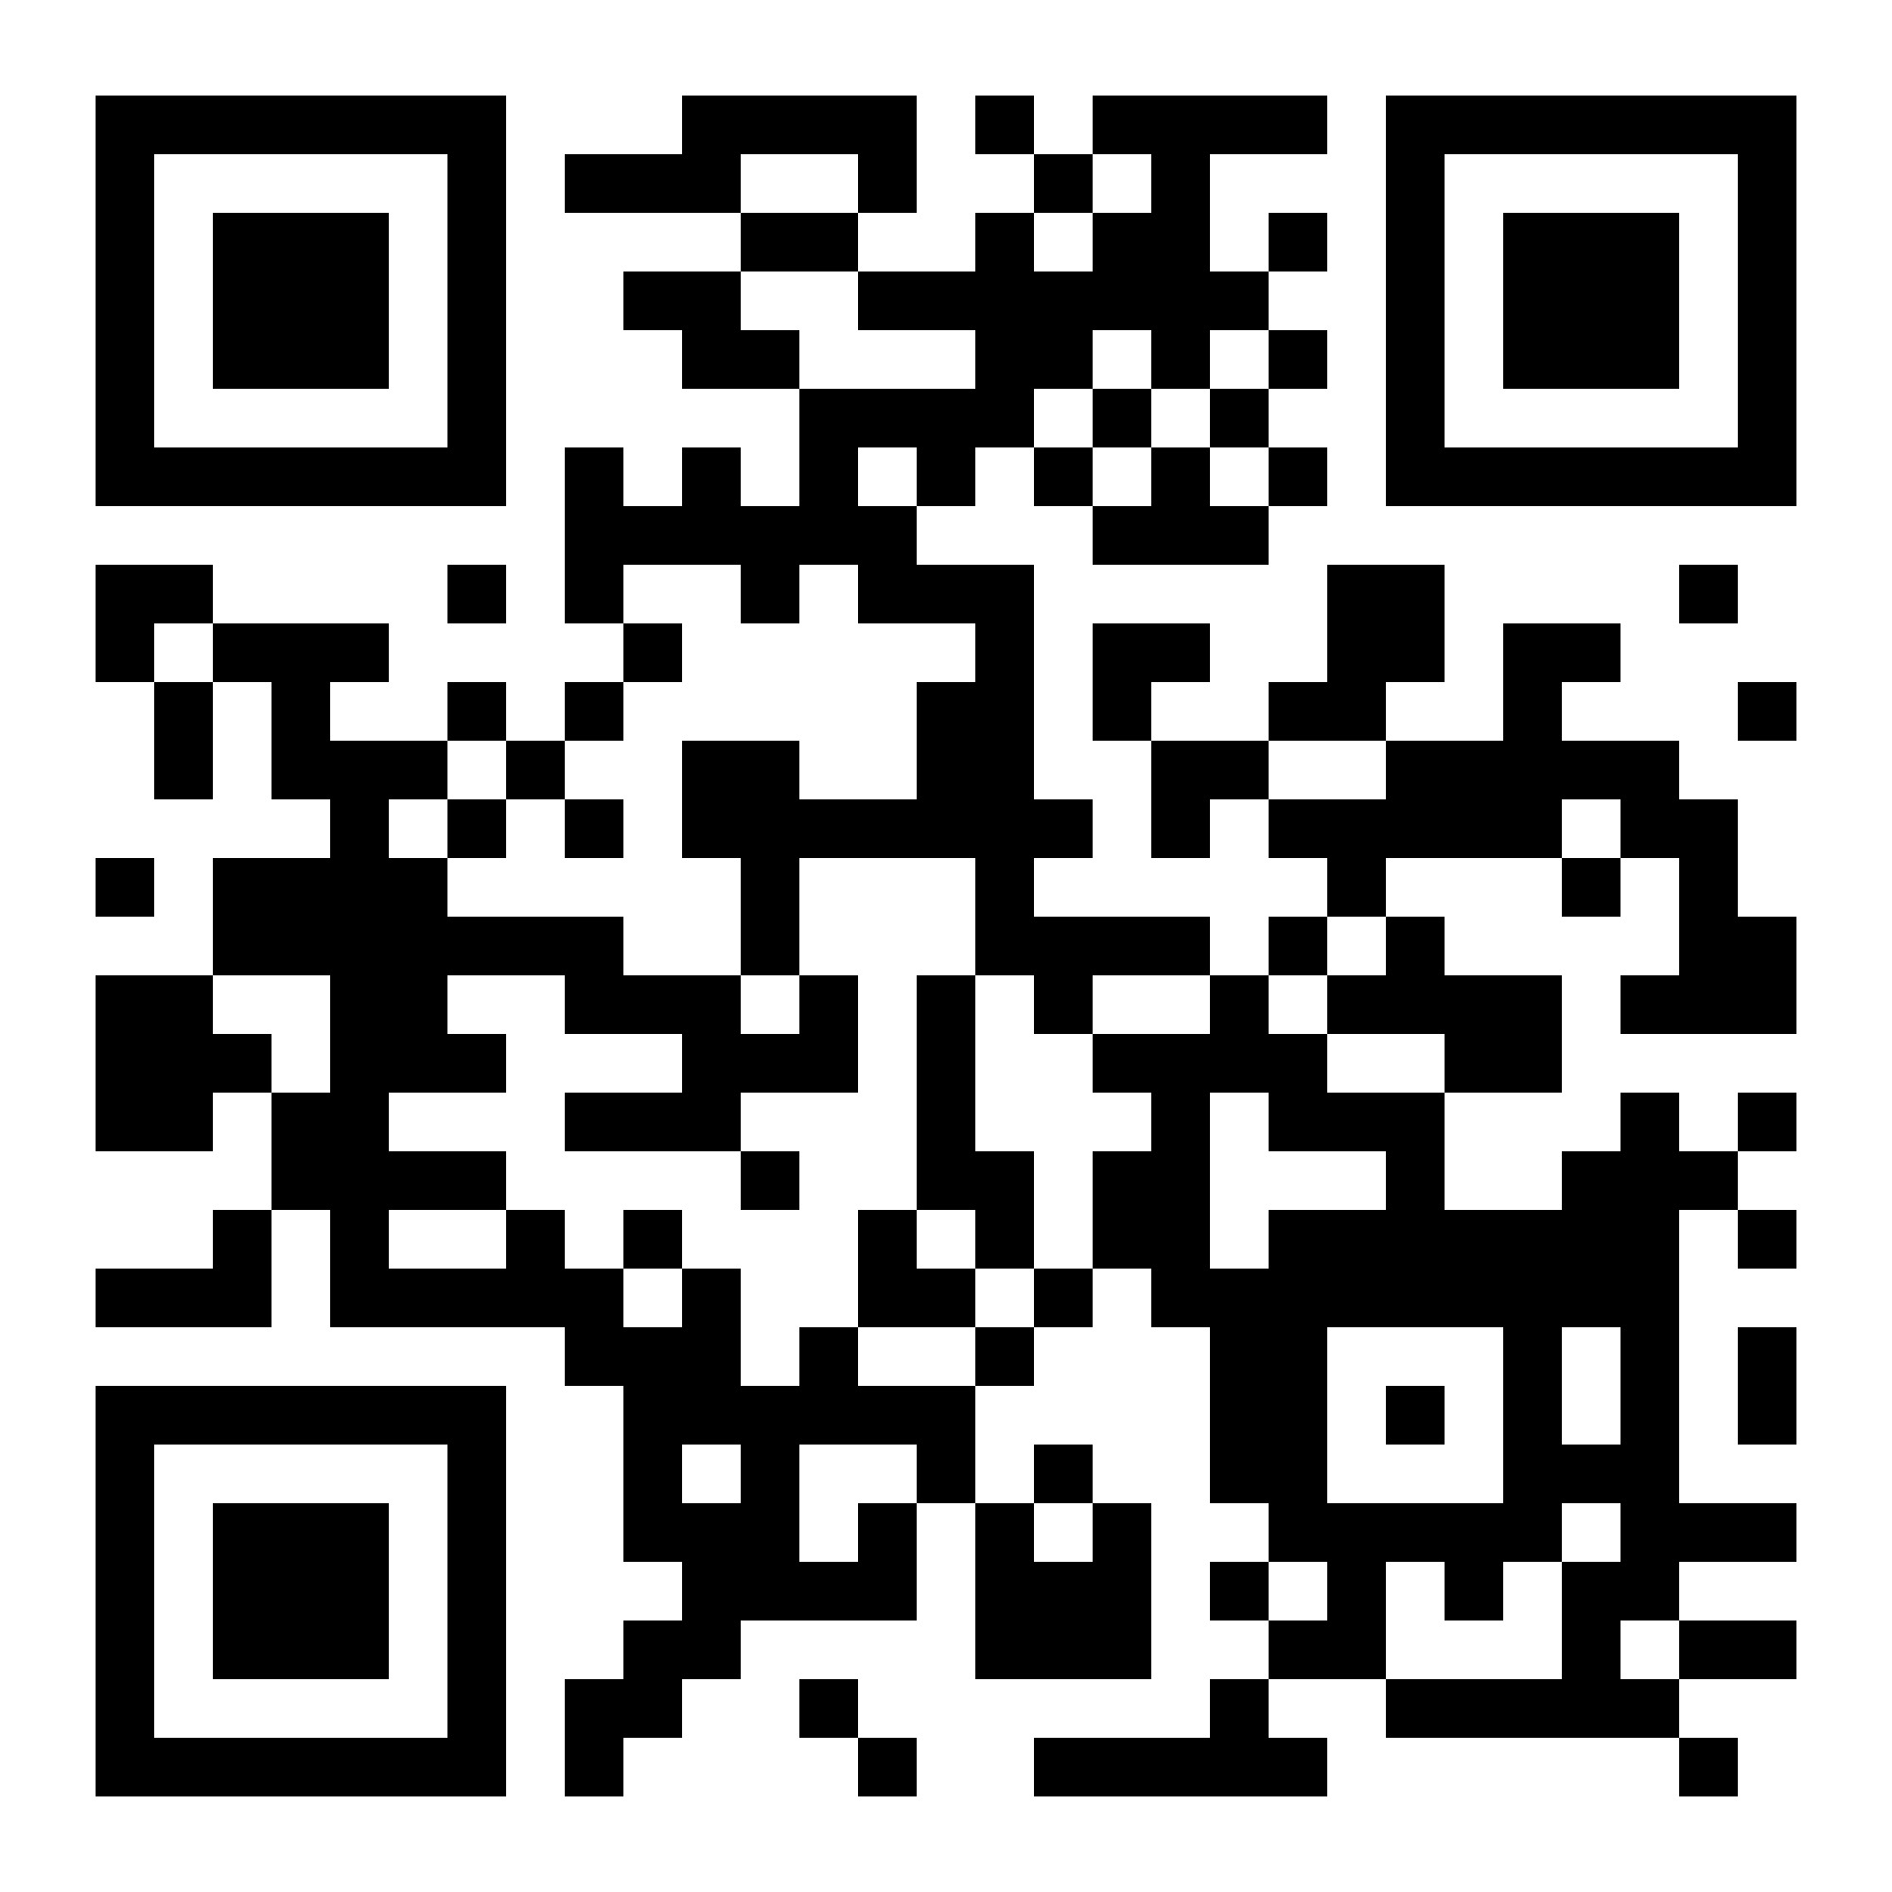

Thank you. Get in touch:
Email prosper.postdoc@liverpool.ac.uk
Website https://prosper.liverpool.ac.uk/ and https://www.liverpool.ac.uk/researcher/prosper/
LinkedIn https://www.linkedin.com/company/prosperproject/
X/Twitter @ProsperPostdoc
Led by
Supported by
An Academy project
Except where otherwise noted, this work is licensed under the Creative Commons Attribution-NonCommercial-ShareAlike 4.0 International License. To view a copy of this license, https://creativecommons.org/licenses/by-nc-sa/4.0/
Notes:
Thank you, enjoy your pizza and continue networking!

