Slide 2
Cheesy connections
Networking workshop with a side of pizza
Dr Stefania Silvestri
Researcher Developer
Led by
Supported by
An Academy project
Notes:
Welcome everyone to today’s session: Cheesy connections: networking workshop with a side of pizza. The session title is self-explanatory: we will work on networking today and end the session with some pizza!

Slide 3
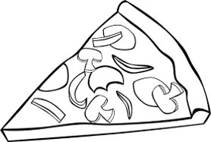
Agenda
Networking strategies
Networking rules
Speed networking round 1 + 2
Final tips
Notes:
This is our agenda for today. We will talk about networking strategies or what you might want to consider when approaching networking. We will then set some ground rules for networking. Following this, and this will be the lengthiest part of the session, we will practice networking through a speed dating type of activity. Finally, we will collect some final tips that hopefully you can take away and reflect on.

Slide 4
Networking strategies
Notes:
So let’s talk about networking strategies. There is a lot of information and there is a wealth of resources on networking that you can use when trying to learn the art of connection with others. Networking in person and online is of course very different, and will require you to use different skills at time. But approaching any type of networking opportunity with a strategy is a good starting point to hopefully have an enjoyable and fruitful experience.

Slide 5
Networking strategies
Define your networking goals
Ask for help and offer value
Work on your personal branding
Follow up and keep your contact warm
Be patient and don't get discouraged
Notes:
On the screen you’ll see a list of networking strategies. When approaching a networking opportunity, having some strategies that you have already reflected on can increase the likelihood of having a more positive experience.
Start with defining your goals: what do you want to achieve through the networking? Do you want to make X contacts? Do you want to meet potential collaborators?
Remember that you bring a value into the conversation: you bring expertise, you have your own connections to put on the table, you can support others’ work. Similarly, you should be ready to ask for help: the more specific you can be, the more likely you are to obtain what you are looking for. For example, you could ask to be introduced to the someone in a more senior position.
Before starting your networking think about your personal branding: do not just state your name and job game, consider what type of information you want to convey (what are the most important things about your role for example) and what language you use to communicate them (avoid jargon for example, you don’t know if you are talking to someone in your exact same field or not!)
If you have made a positive connection, remember to keep that contact warm. Follow up at a later date, a couple of weeks for example, with an email. Share some information you had discussed in your first conversation (a paper you mentioned) and suggest a further contact, such as a meeting or a chat over a coffee.
Remember to be patient: you might not get successful contacts at the first go, or a follow-up opportunity might not come to fruition, and that is discouraging, but it is a numbers game, so it is worth being persistent.

Slide 6
Networking rules
Notes:
Following from the strategies, it is worth keeping in mind some brief rules. These apply to all networking opportunities, but especially in this session for the practical activity you are about to take part in.

Slide 7
Networking rules
Be open
Be a good listener
Engage in discussion
Exchange contact information if you find potential collaborators
Notes:
Be open, so be ready to answer questions. You can keep it professional; you don’t need to share personal information if you do not wish to.
But at the same be a good listener, don’t just pretend you are. Listen and ask follow-up questions.
Have a lively positive discussion, don’t make it a monologue
And if the three points above have gone well, remember to exchange contact information!

Slide 8
Speed networking
Notes:
And now it’s time for your speed networking activity.

Slide 9
Two rounds with 5 minutes break
Ring a bell every 3 minutes
Inner circle moves one person to the right
Prompts on table
Notes:
We’ll have 2 rounds of 15 minutes each with a 5 minutes break in between.
You’ll have 3 minutes to talk in a pair and I will ring the bell when the time is up
Those in the outer circle stay where they are
Those in the inner circle move one seat to the right when I ring the bell.
To help you with getting started you have some prompts on the table that you can use.
Facilitator: timings can be adapted depending on audience size

Slide 10
Final tips
Notes:
I hope you enjoyed the speed networking. Before finishing the session, I’d like to go over some final tips around networking.

Slide 11
Final tips
What have you learnt about networking today and what would you tell your colleagues/friends?
What are your top tips?
Notes:
Rather than providing you the tips, I’d like you to suggest some based on your own experience of networking, both today and in previous occasions. So think about what you have learned and what you would tell others about how to approach networking.
Facilitator: open up the floor for input from audience. Guide the conversation.

Slide 12
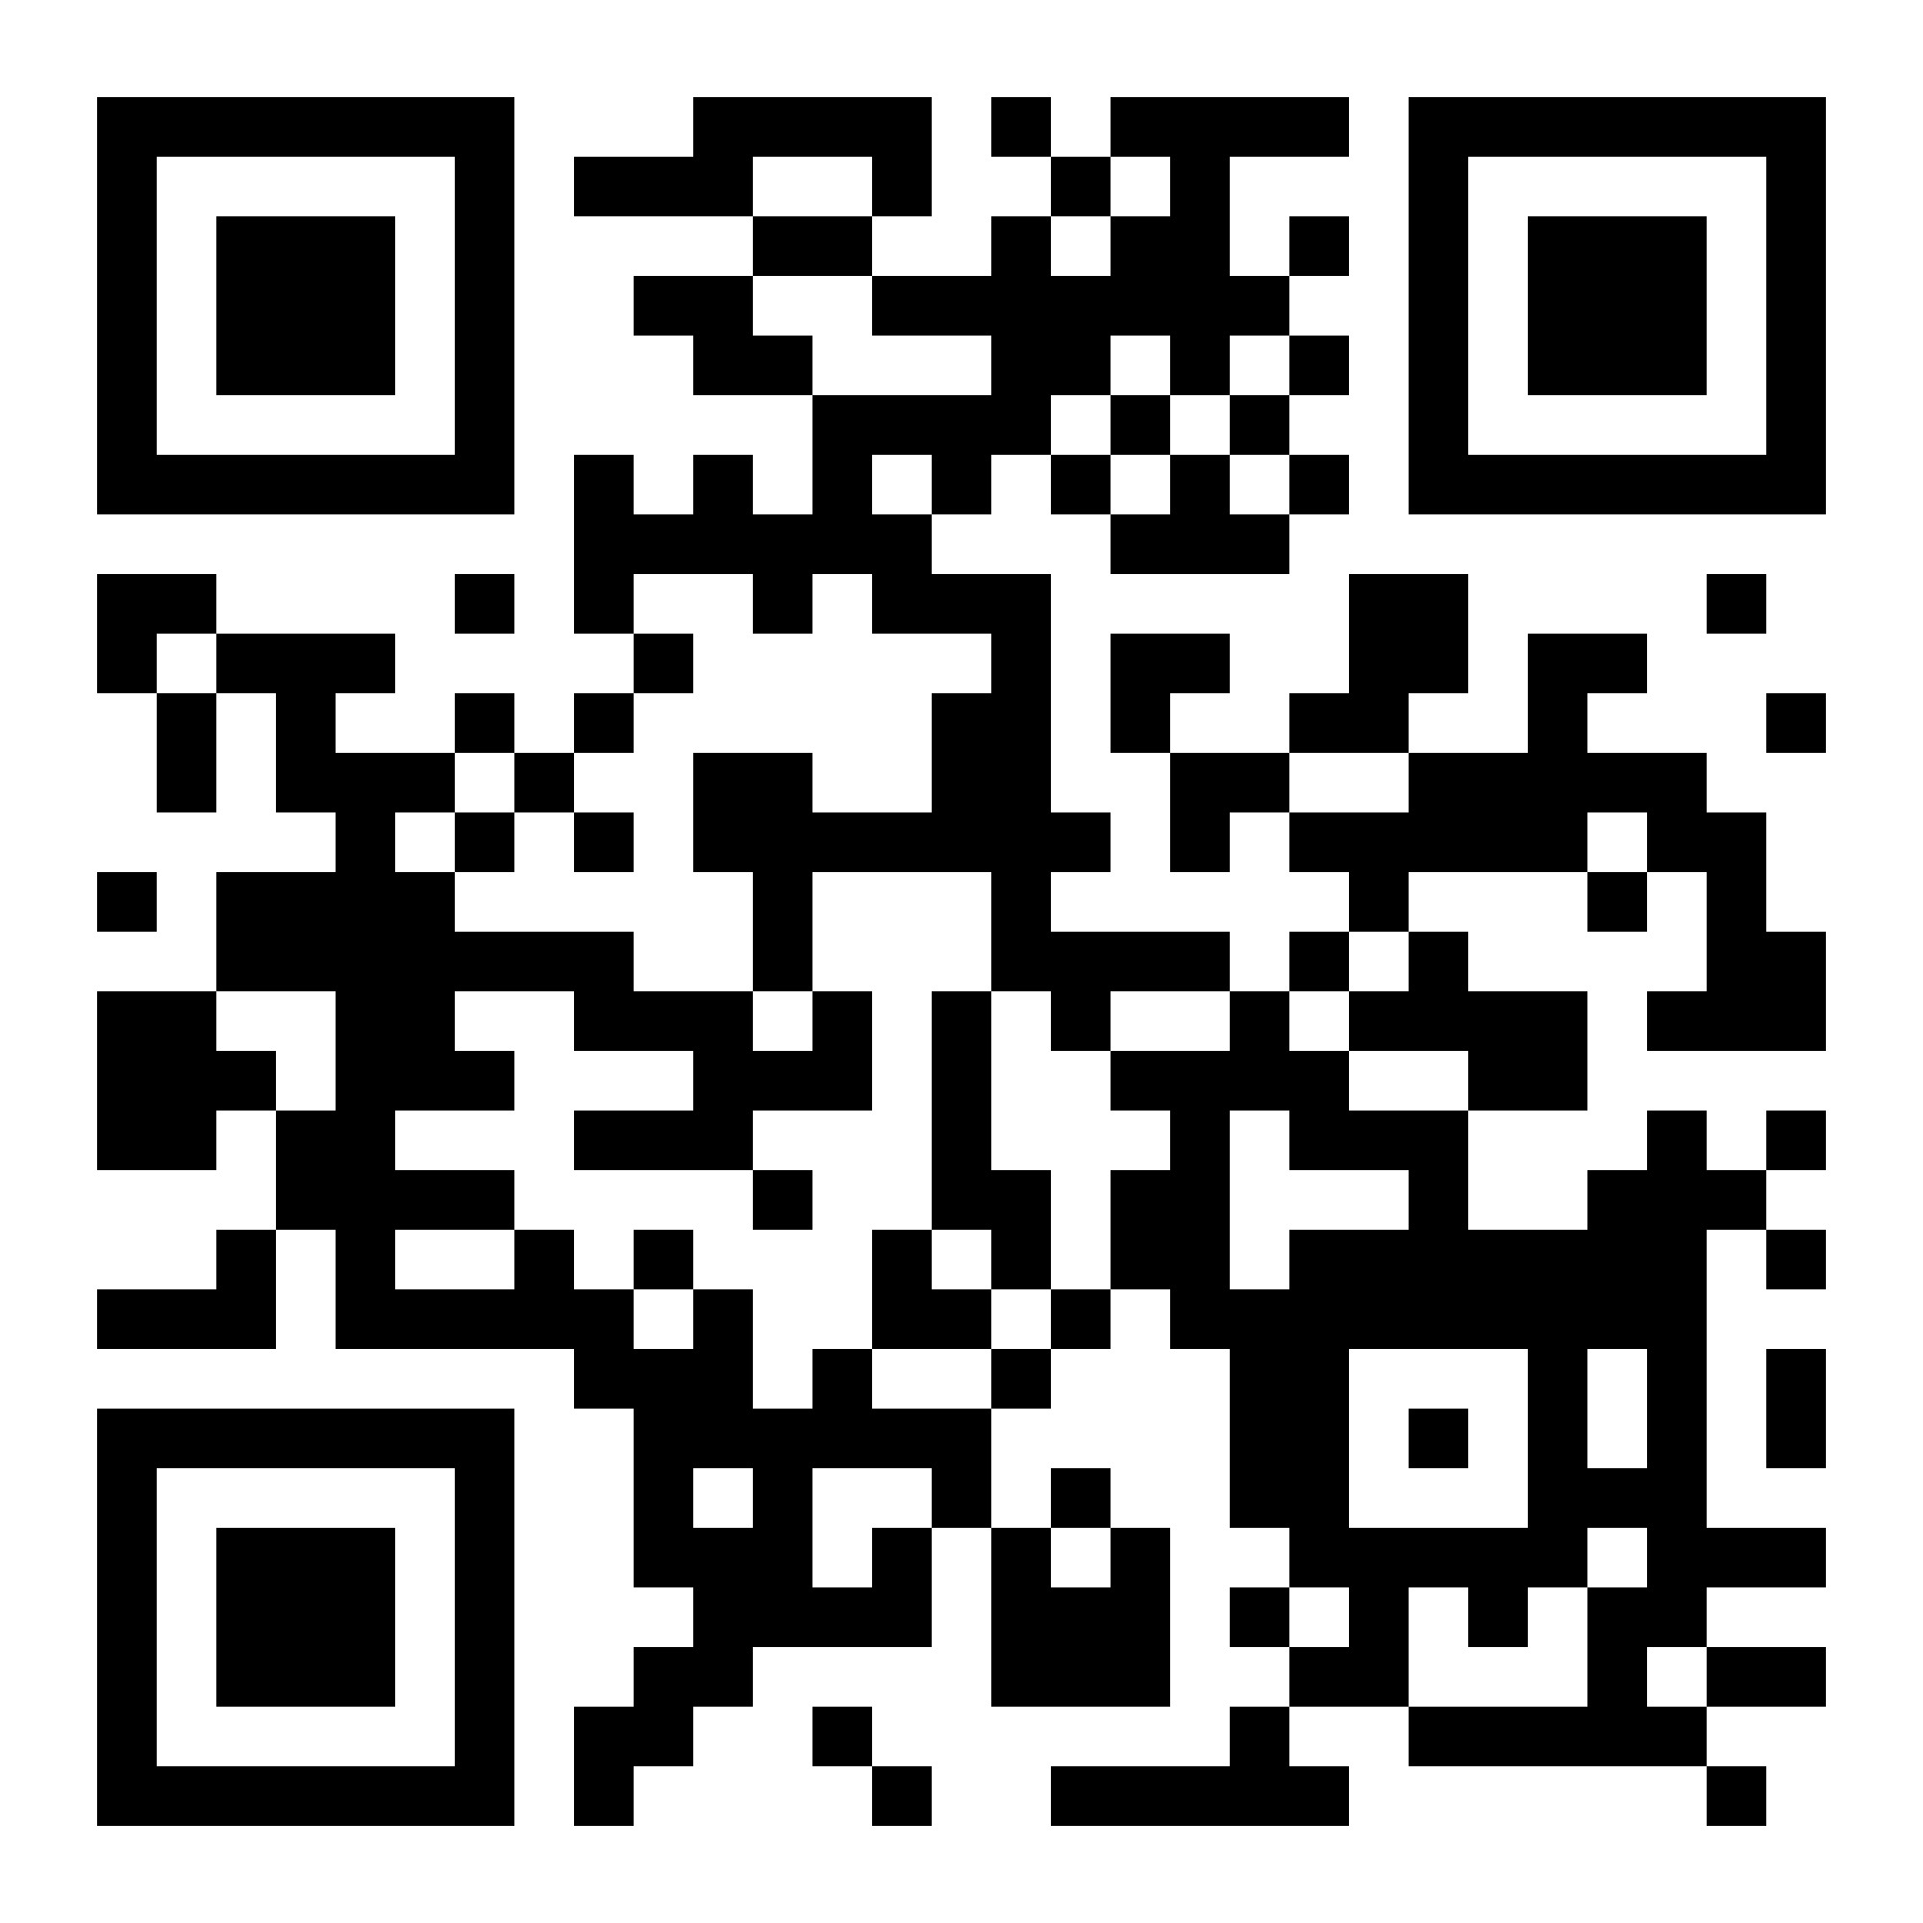
Thank you. Get in touch:
Email prosper.postdoc@liverpool.ac.uk
Website https://prosper.liverpool.ac.uk/ and https://www.liverpool.ac.uk/researcher/prosper/
LinkedIn https://www.linkedin.com/company/prosperproject/
X/Twitter @ProsperPostdoc
Led by
Supported by
An Academy project
Except where otherwise noted, this work is licensed under the Creative Commons Attribution-NonCommercial-ShareAlike 4.0 International License. To view a copy of this license, https://creativecommons.org/licenses/by-nc-sa/4.0/
Notes:
Thank you, enjoy your pizza and continue networking!

