Slide 2
Prosper – unlocking postdoc career potential
Boilerplate slide deck

Slide 3
Prosper Overview

Slide 4
What is Prosper?
Prosper is an innovative approach to postdoc career development that seeks to unlock postdocs’ potential to thrive across multiple career pathways – both within and beyond academia.
Prosper is used by 70+ HEIs across the UK and beyond. Tried and tested, its model and associated online Portal is freely available to whole sector.
"What Prosper has built is very impressive, and the impact it has had on postdoctoral researchers in its pilot phase is extremely promising. I believe Prosper can play a leading role in driving best practice in developing postdoctoral research careers and strongly encourage research institutions across the UK to adopt and make use of Prosper resources."
– Professor Dame Jessica Corner
Executive Chair, Research England

Slide 5
What is the Prosper Portal?
The Prosper Portal is a free-to-use online hub containing a wealth of information, tools and resources for postdocs and managers of researchers.
The Prosper Portal Institutions section contains ready-made materials and guidance for HEIs to enhance their own postdoc career development offerings with Prosper.
"One of the main benefits of Prosper for us is that it's there as a resource that people can tap into in their own space and their own time.
I've heard from postdocs here that they like having that independence in terms of their own development - and that it's great having the Portal as a reliable source of information for them to explore."
– Dr Alison Monkhouse,
Academic Researcher Development Manager, University of Huddersfield

Slide 6
Co-creating Prosper
Prosper's approach to co-creating a sustainable model of postdoc career development for the whole sector was guided by these three pillars:
Co-creation with employers
Recognising the role of
Principal Investigators
Democratisation of access

Slide 7
Prosper's co-creation
Postdocs Developed with 120+ postdocs, selected to represent the diversity of the UK's postdoc population in terms of gender, ethnicity and discipline. | Managers of Researchers Informed by a vibrant community of Principal Investigators and Managers of Researchers, via the Prosper PI Network.
Employers Co-created with 100+ employers, large and small, across the breadth of the economy. | The wider sector Piloted across the University of Liverpool, University of Manchester and Lancaster University, and developed with input from 20+ institutions

Slide 8


The Prosper model
Figure out what you want from your career
Reflect
Community
and
peer learning
Learn about the employment landscape
Skills for your whole career, wherever it takes you
Explore
Act

Slide 9










Prosper's history
November 2019 – August 2023
October 2023
February 2025
August 2026
Prosper model co-created and piloted across our three partner institutions
The PI Network – a forum for PIs to share practice and develop leadership skills – is launched to sector
The first Prosper Practice Exchange event, hosted in Manchester
End of UKRI rollout funding and transition to business-as-usual
October 2019
September 2023
January 2025
February 2026
Prosper begins as Research England Development (RED) fund project
RED funding ends, Prosper becomes UKRI-funded. Prosper launches to sector and begins rollout.
Prosper cohorts delivered at nine Higher Education Institutions across the UK.
Launch of the Prosper Exchange – a reciprocation framework for sustaining Prosper’s impact across the sector

Slide 10
Prosper rollout stats (August 2025)
Over 1.5k
Portal registrations
Over 70
institutions using Prosper
10
institutions running Prosper cohorts
14
UK sector bodies promoting Prosper
PI Network sessions attracted attendees from over 100 institutions
Employer Insight sessions open to all attracted attendees from 65 institutions

Slide 11
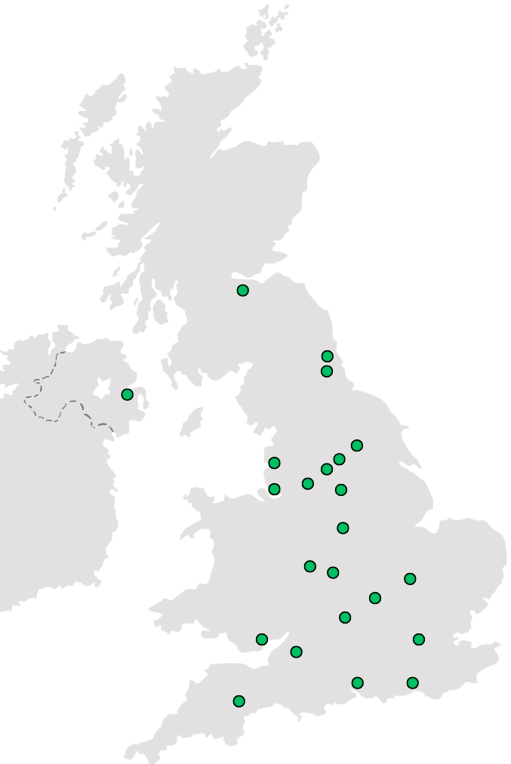
Prosper’s reach (August 2025)
Green dots represent UK HEIs that are actively implementing Prosper via one of the modes of delivery (some dots represent multiple institutions in the same locale).
“Prosper is really helping to fill an enormous gap!”
– Sue Glover, Researcher Development Project Officer, University of Reading

Slide 12
Examples of Prosper's impact
Confidence
Behaviour
Outcomes
“I don’t think that I’d have had the confidence to interview for my current role if it hadn’t been for Prosper.”
– Dr Catherine Hayer,
former science and engineering postdoc
“Prosper really helped me understand the extent to which persistence is the key to success – get in contact with recruiters, be bold about what you apply for, keep going until you find the role that matches both your essential and desirable criteria.”
– Dr Priyanka Raina,
former life sciences postdoc
“Prosper changed my working life! I joined with an idea of what career I wanted in the long-term, but not how to get there. Prosper was a great help in preparing applications and searching for my next position – I felt like I had everything I needed to be successful.”
Dr Egidijus Kukstas,
former chemistry postdoc

Slide 13
Prosper for postdocs

Slide 14
Prosper for postdocs:
Reflect – identify skills, build confidence, discover career priorities
Explore – career paths and employer insights across 12 career clusters
Act – practical skills for continuous development
Community – resources to support postdoc peer-to-peer development
"Prior to Prosper I felt so lost in my career. Unsure what to do next and not having the confidence to take the next step or any sense of what that step might be. Prosper equipped me with the knowledge and tools I needed to change direction and to aim higher in my job search."
– Dr Zohra Butt,
former life sciences postdoc

Slide 15



The Career Development Navigator
What job would suit me?
9
Thrive wherever you are
1
Tailor your career exploration and expand your network
Develop the right skills
6
8
5
Prepare for the next step
Is now the right time to make a change?
7
2
Find the right direction for you
4
Discover what’s out there
Options and challenges
3
The Career Development Navigator is a tool for navigating Portal resources through common career questions, which registered users of the Portal can tailor to their own career development

Slide 16
Prosper for Managers of Researchers

Slide 17

Prosper for Managers of Researchers
Champion career development for postdocs
Grow leadership and management skills
Foster a positive, inclusive working environment
Connect and share best practice with other managers across the UK via the Prosper PI Network
"[The PI Network] is a very innovative project to support PIs, rolling it out across the sector and ensuring it remains free to use."
– Staff Development Forum Developing Excellent Practice Awards 2024: Gold Award

Slide 18
Prosper for Institutions

Slide 19
Prosper for Institutions
A free-to-use career development model, co-created and developed on a cross-institutional basis
Use Prosper flexibly to enhance existing provision – whether you're running a Prosper cohort, simply signposting the Portal, or adapting resources to your local context
Collaborate with Prosper and the sector via the Prosper Exchange
"Prosper was fantastic because while we’ve historically offered a lot of training and standalone sessions, this was the first opportunity we’ve had to run a programme just for postdocs where everything is joined up in a holistic way."
– Chris Emmerson,
Organisational Development Lead, Newcastle University

Slide 20
The Prosper Exchange
HEIs can access enhanced support from Prosper, in return for an "in-kind" contribution.
Examples of enhanced support include session facilitation (e.g. a Portal tour for postdocs at your HEI), train-the-trainer, consultancy around implementing Prosper, and data on Prosper Portal usage at your institution.
Examples of in-kind reciprocation include leading a PI Network or Employer Insight session, sharing new resources for the Portal, or providing case studies and/or testimonial.
These are just examples, we welcome your ideas! Visit the Prosper Exchange page to get involved.
"Over the last couple of academic years, we’ve run a series of career development sessions for postdocs and PGRs all built around the use of Prosper resources. I provided Prosper with anonymised evaluation data, as well as helped them put together a case study on our approach, which serves an example to other institutions.
In Exchange, prosper ran a portal tour session for our postdocs during National Postdoc Appreciation Week, which showcased the wide range of resources available on the portal."
– Dr Gabriele Anderson,
Researcher Development Consultant,
Heriot-Watt University

