Slide 1
Research Canvas
A tool that empowers researchers to develop impactful & fundable research projects while honing skills for academic excellence and transferable to diverse careers
Prosper PI session 4th June 2025
Dr Katia Smith-Litière,
Development Consultant (Entrepreneurial skills)
Postdoc Academy (PdA)

Slide 2
Today’s session
Learn to use the Research Canvas Framework
  to empower early-career researchers in shaping their own ideas into compelling, fundable projects — while supporting their progression toward research independence or diverse future careers.
  to align your team to your/the team’s overall research vision and for structuring and stress-testing new research directions in your own work

Slide 3
Actions after this session
Introduce the Research Canvas during team meetings or proposal development discussions
Use it to help early-career researchers develop research ideas - think through all aspects that make a research proposal competitive – focus on aligning with challenges, funding priorities
Use the Canvas to match ECR’s ideas with potential funding calls or industry interests.
Encourage ECRs to fill in the Research Canvas before they reach out to grant administrators/research facilitators
Support researchers in identifying and building skills beyond the lab
Use the Research Canvas to identify specific skills and encourage participation in workshops that develop e.g. communication, stakeholder identification, project planning.
Practice research “elevator pitches” in group meetings using the Canvas as a foundation. Invite collaborators or non-academic stakeholders to provide guidance and feedback on project presentations
Embed the Research Canvas in mentoring conversations and funding strategy sessions
Treat it as both a training and planning tool—helping your team grow while aligning with funder expectations.
Develop and share your own Research Canvas maps for new member onboarding and for communicating new research directions.

Slide 4
Growing pressure to demonstrate real world impact and develop transferable skills of researchers
UK
Government
Increasing innovation, boosting economy​
…looking for “demonstrable contribution that excellent research makes to society and the economy”
Incentivise flexible careers …..moving easily between disciplines, sectors, business and academia.​
UKRI/Funders of Research
Deliver real impact - academic, economic, societal, technological or policy-led
Working together within the University and with academia, industry, government, cultural institutions and third sector partners across the world
Measured via REF, KE,KT and employability
Universities

Slide 5
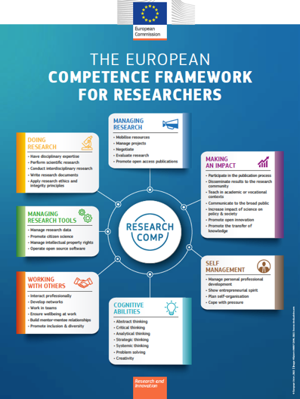
European competence framework for researchers
“It is important that they are equipped with the transferrable skills necessary for effective and successful careers in all relevant sectors of the society, including academia, industry, the public administration and the non-profit sector”
Developed by the European Commission in close consultation with relevant stakeholders
https://research-and-innovation.ec.europa.eu/system/files/2023-04/ec_rtd_research-competence-presentation.pdf

Slide 6

What postdocs hear and what they tell us
“You should apply for a grant or fellowship”
  Lack of guidance on funding – what is the funding available? Where to find the info, how to approach the process? What makes an application competitive? How to get started, who to talk to for advice? Where can I find support resources?
“You should ask people for insights and support”
  Concern and hesitancy
  Etiquette? Fear of being bothersome. Intercultural dynamics (approaching someone more senior?)
  Lack of network
They don’t know – but everyone may assume that they know and therefore they are afraid to ask

Slide 7
Entrepreneurship training gives researchers a powerful edge
… whether staying in academia or moving beyond
Equips researchers with a powerful mix of mindsets and transferable skills that enhance their effectiveness within academia and prepare them for diverse future careers across sectors.
But low % of researchers are motived by entrepreneurship and engage with entrepreneurship programmes

Slide 8
Exposing researchers to entrepreneurial skills and mindset training affects researchers positively
“Running a research group and running a start-up is actually very similar”. You have to use the same skill set. You need a vision, communicate that vision effectively to allow people to relate and makes them want to fund you and work with you under conditions of uncertainty.”
“Before engaging in entrepreneurial training, I believed that academia and the world of innovation and entrepreneurship had little in common. How mistaken I was!”
“I learned that it’s not a ‘bad thing’ to start a venture whilst at university; it can be a great synergy for the university and for researchers with the aspirations to start a venture based on their research.”
“Pursuing different avenues that are peripheral to your research enriches your personality and it makes you more aware of the reality around you, and hence a more realistic researcher.”
“The course greatly changed my perspective on what is possible with academic research - particularly with respect to producing a strong societal impact”
“Whenever I now have an idea, I try to think of it as a business case. I put together enough information to make a strong enough case to present it. “

Slide 9
Barriers to engaging with entrepreneurship training
X Common concerns
“Business and commercialization puts me off”
“Entrepreneurship programs are not relevant to me, I don’t want to start a company”
“ I don’t have time, my research takes priority as I want an academic position”
“ I don’t understand business language. I lack confidence to engage”
“ I’ve fought hard for recognition in Academia , I do not want to look stupid in business environment ” (woman researcher)
Some PIs think that entrepreneurial training is a distraction to the research activities postdocs are employed to carry out

Slide 10
The Research Canvas as a Multi-Purpose Tool
A Win for Mindset, Skills & Funding
Sharpens the Research Value Proposition & Boosts Grant Competitiveness
Develops Mindset & Transferable Skills
Entrepreneurial mindset and skills not seen as niche, but part of mainstream professional development

Slide 11
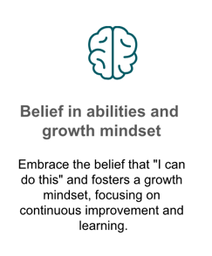
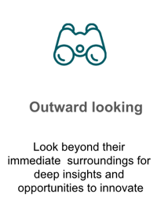
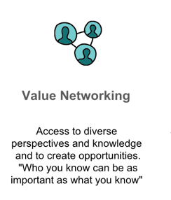
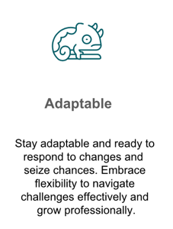
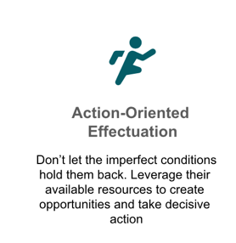
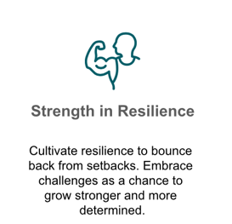
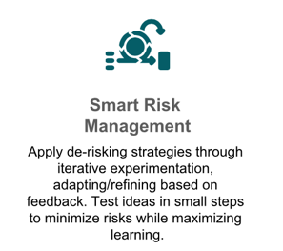
Entrepreneurial mindset:
A set of mental habits that empower individuals to spot and seize opportunities in diverse environments

Slide 12












University/ Research Institute
Start up/ Established Business/government /charity
Original/Novel Research (fundamental/translational)
Innovation – product /service development
Researcher/Academic
Similarities
Innovator/Entrepreneur/Intrapreneur
Passionate about identified research problem
Passionate about real world need or opportunity
Grant applications
Business Plan | Business Case
Experiments | Interventions | Publications
Product or Service development |New research area
Research - Funder fit
Product - Market fit
Scientific/Research Method
Entrepreneurial Method/ Customer discovery
PhD Students, Postdocs, Collaborators
Cross-Functional Teams (Business, Technical, Market)
Change to research method |direction
Pivot to Meet Market Needs

Slide 13
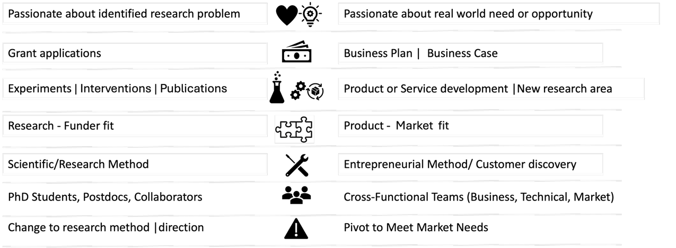
University/ Research Institute
Start up/ Established Business/government /charity
Original/Novel Research (fundamental/translational)
Innovation – product /service development
Researcher/Academic
Similarities
Innovator/Entrepreneur/Intrapreneur
To achieve Impact through Industry collaborations, translational research, licensing, pursue a spin out, consultancy, policy engagement; enabling societal change through interventions etc,
Researchers benefit from gaining business knowledge and skills!!

Slide 14
Business Model Canvas
Customer Value Proposition
Research Canvas

Slide 15
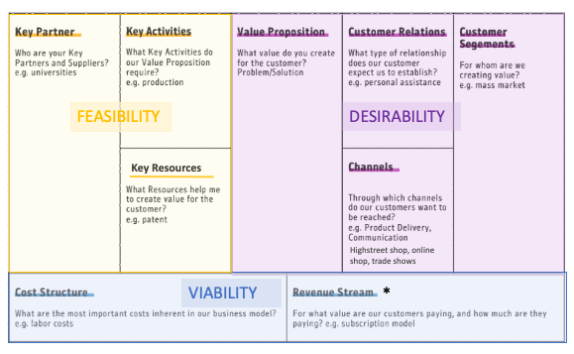
Business Model Canvas
2 minutes explanatory video
From STRATEGYZER: https://www.youtube.com/watch?v=QoAOzMTLP5s
How a business creates, delivers & captures value
Designed to help create a quick snapshot of the idea, share it with key stakeholders for feedback and for validating assumptions.
It helps define what they do and why and whom will benefit from what they do and whether the business is viable.
The assumptions are refined iteratively by talking with key stakeholders
Used as a tool to support a compelling business pitch
Explore range of company business /revenue models: https://businessmodelnavigator.com/explore

Slide 16

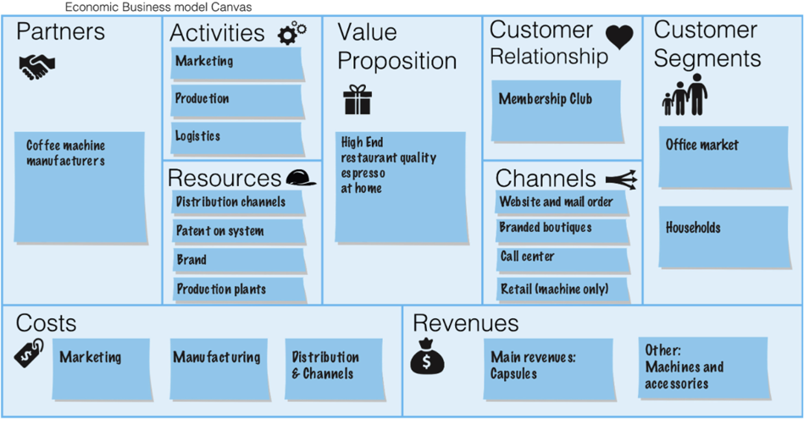

Example: Nespresso
Source: The triple layered business model canvas: A tool to design more sustainable business models. Joyce and Paquin. Journal of Cleaner Production, Volume 135, 1 November 2016, Pages 1474-1486 https://doi.org/10.1016/j.jclepro.2016.06.067
Make sure you access the full article to see the figures

Slide 17

Figuring out the problem(s) to solve and identify who the customer(s) are

Slide 18
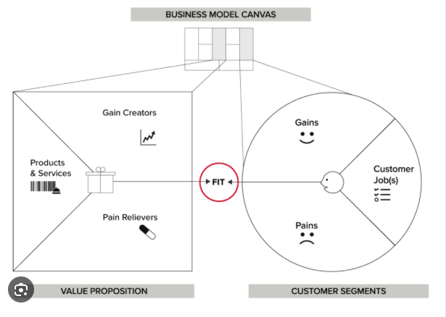
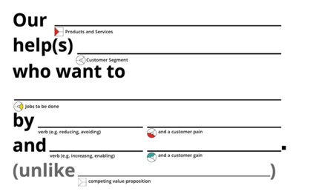
Customer value proposition
Watch 2 minutes explanatory video
https://www.strategyzer.com/library/the-value-proposition-canvas
Fit between what company offers and what customers need and want
How to describe the value proposition for a particular customer segment:
Check out: Innovate UK ICURe programme – Discover programme for start ups

Slide 19
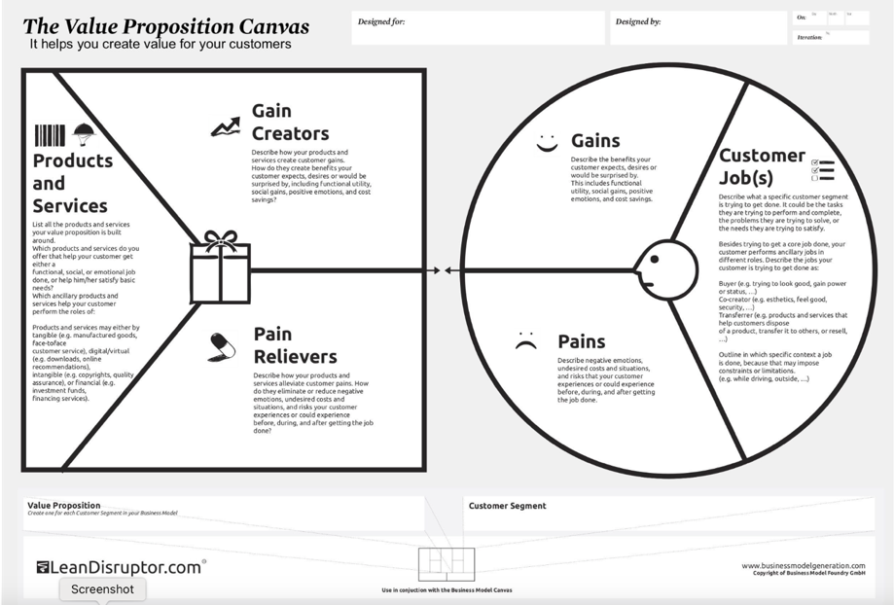
Do you have a business idea?
What and who’s problem will it solve?
Exercise:
Start with your hypothesis of what the problem is:
Identify your customer segments
Identify their pains and gains (secondary and primary research)
Download a free CVP canvas
https://www.strategyzer.com/library/the-value-proposition-canvas

Slide 20
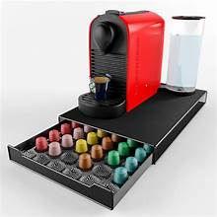
Nespresso CVPs
Clear product description
Customer segment
Value
Addressing major pain
Home coffee consumers
Our user friendly Nespresso machines and high quality coffee blends in single serve capsules provide our home coffee consumers with convenience and simplicity to make a cup of quality coffee -every time without the need for complicated brewing techniques
Nespresso has identified additional customer segments where their products provide value
Busy professionals
Hospitality Industry
Our user friendly Nespresso machines offer busy professionals gourmet coffee by using single serve capsules and quick brewing times
Coffee enthusiasts
Gift shoppers

Slide 21
Introduction to the
Research Canvas
Applying business tools in academic context
to secure funding for research while honing transferable skills
The research canvas is an adaptation of Ash Maurya's Lean Canvas (www.leancanvas.com) which he in turn adapted from Alexander Osterwalder's Business Model Canvas and Strategyzer.com . Adapted by Dr Katia Smith-Litière, December 2018

Slide 22
Over to you
Your experience
You can unmute yourself and tell us or add your answer to the chat
What support do you currently offer to ECRs in your team when they are starting to develop their own research ideas?
  What challenges do they encounter?
  What have you found helpful in enabling them to overcome those challenges?
What support/advice did you get that was really helpful to you?
Notes:
Question: What challenges do your researchers face when trying to develop independent research ideas and apply for research funding or fellowships? [Free text]
Question: How do you currently support your ECRs in refining their own research ideas and articulating a clear research value proposition and with grant writing ? Free text

Slide 23
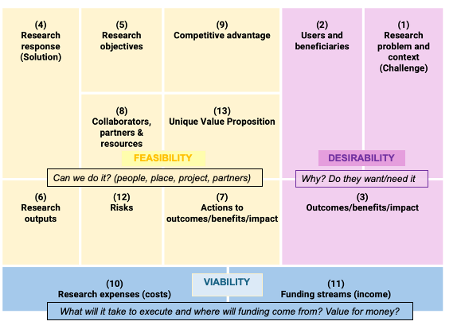
Research Canvas
A visual dashboard
Collect information about all aspects related to the proposed research ahead of writing grant or fellowship proposals for specific funders
Easy, visual format that allows you to share, revise, refine with PI, academic and non academic collaborators and stakeholders, funders
Assist in designing and planning a persuasive case for funding
https://www.postdocacademy.cam.ac.uk/research-canvas

Slide 24
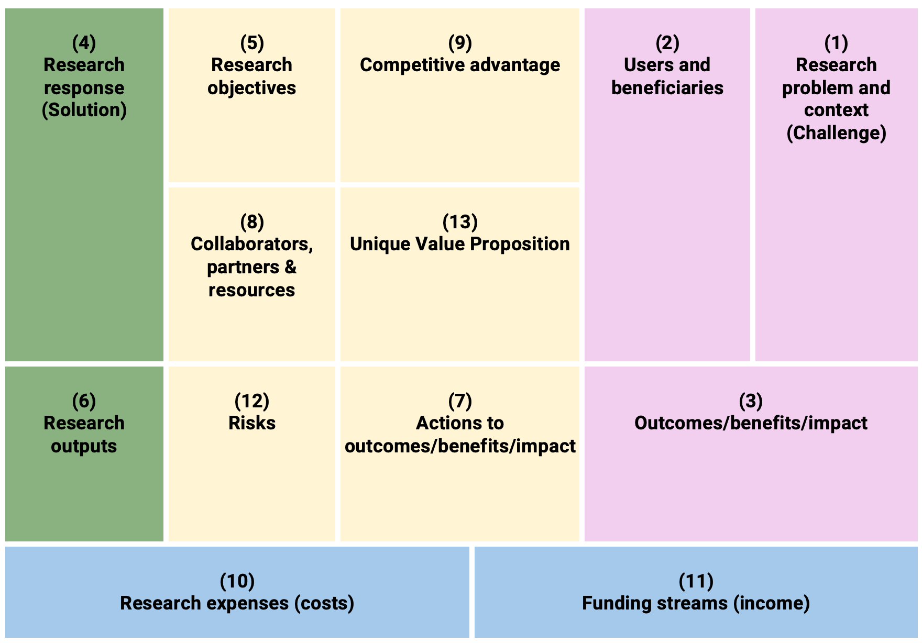
Research Canvas – early stages of translational research
The Research Canvas is also appropriate for planning to secure funding for translational research
In this case, the “Research response” and “Research output” is the research already is caried out/output already achieved.
Funding is required to develop the research outputs and show experimental proof of concept and that it has practical potential, further technology validation testing for specific application etc
For Further advanced projects, with an identified customer/market/ application, the Business Model Canvas is more appropriate
FEASIBILITY
DESIRABILITY
Can we do it? (people, place, project, partners)
Why? Do they want/need it
VIABILITY
What will it take to execute and where will funding come from? Value for money?

Slide 25
Guidance Research Canvas
Is a working document- use bullet points and short sentences
An enabler to start discussions with key stakeholders
Your starting point will include assumptions you have around the problem, the beneficiaries, the outcomes and these may need validating, refining before starting to write an application
Specific information is needed to make it compelling – secondary and primary sources
Helps you make strategic choices about who to highlight as collaborators, the beneficiaries and impact
https://www.postdocacademy.cam.ac.uk/research-canvas
Notes:
OVERALL GUIDANCE
The different boxes will not necessarily correspond to specific sections in grant proposals - this is intentional
The tool takes a wider view of the research and impact and when it comes to writing the proposal, you will be able to take and combine information from the different sections of the tool.
It covers all aspects of the research to consider to make it a competitive research project
Funder agnostic - Each funder is different, you will need to look at their mission and strategic priorities and other requirements and adapt writing the grant applications tailored to each funder.
Numbering shows recommended sequence to use the tool, starting with "what is the context for your research, what problem will your research address? ”
The size of the box does not correlate with the importance of that section/topic
Use bullet points and short sentences that bring out the key points– you can elaborate on these in the grant applications.
The slides that will be shared have detail on what researchers need to consider in each of these topics and provides them/you with suggestions on where they can find resources at their university or who they could reach out to for support. I will focus on a number of key topics we know researchers struggle with

Slide 26
Over to you
Question: How confident are you that your postdocs and PhD students can frame their research within a broader societal or strategic context ((e.g., Sustainable Development Goals, Industry or societal challenges, national priorities)?
5= Very confident
4= Somewhat confident
3=Neutral
2=Somewhat unconfident
1=Not confident at all
Please type your answers in the chat

Slide 27


Desirability
Research response (solution)
Research objectives
Competitive advantage
Users and Beneficiaries
Problem and context (Challenge)
Key collaborators, partners and resources
Unique (value) proposition
v
Actions to achieve outcomes/impact/benefits and metrics
Outcomes/Benefits /Impact
Research output
Risks
Research expenses (Costs)
Funding streams (Income)
To establish the value of your research, you need to start with:
Identifying (and articulating) a clear need for your research or problem your research will address
Identifying who’s problem this is and who will benefit and how
Then, you propose what you’re going to do and how and how the proposed research outcomes will solve (or be a key step towards solving) the problem/need

Slide 28
1. Problem & context (challenge)
Research response (solution)
Research objectives
Competitive advantage
Users and Beneficiaries
Problem and context (Challenge)
Key collaborators, partners and resources
Unique (value) proposition
v
Actions to achieve outcomes/impact/benefits and metrics
Outcomes/Benefits /Impact
Research output
Risks
Research expenses (Costs)
Funding streams (Income)
Establish project need
Identify problem
Place problem in Context
Highlight problem size and importance of
solving/addressing the need
Use Persuasive Information - evidence to back up your problem statement
Build on Existing Research (others and yours)

Slide 29

Be more outward looking – wider context of research - WHY
Change in funding landscape
Change in regulations that will affect specific sectors
Changes in societal behaviour
Industry trends and challenges
New technological developments
Anticipate change
See opportunities

Slide 30
Methodology- building knowledge & skills
To identify new research opportunities or applications of research
Secondary Research:
What is already available, done by someone else
Primary Research:
What you do
&
Desk based research – gather data from range of sources
published research papers (a known source)
Industry and market reports,
Patent documents
Industry insight reports
Government sources – emerging policy issues
Directly talk to people that can provide valuable insights
Interviews, surveys, focus groups etc
Who to talk to to gather insights (identify people)
Where to find them
What to say to attract attention and gain support

Slide 31
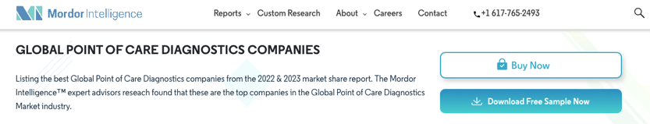
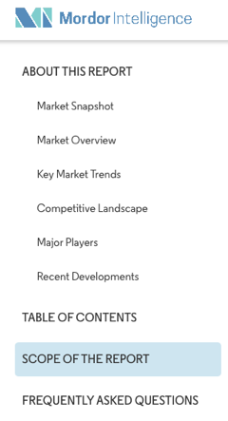
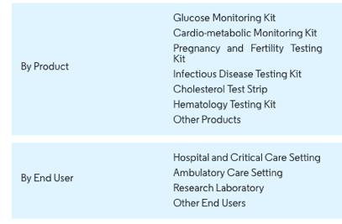
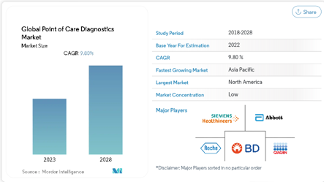
Methodology: Market/Industry Reports
Expensive!
Table of contents, trends, companies, and more info available for free
$4750
The University may have access to the full market report, but under academic license-which means that you cannot use the information for commercial purposes, only academic research. You can however use the information provided for free by the report company on their website and as sample download

Slide 32
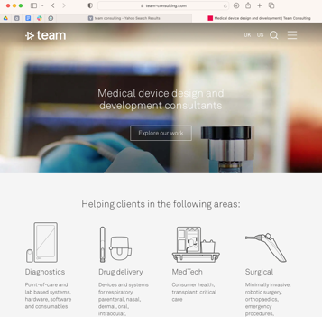
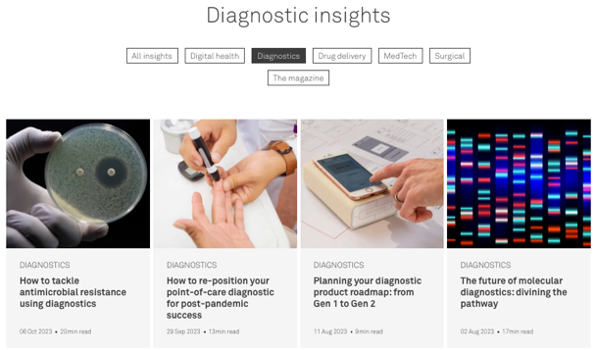
Methodology: Consultancy insight reports
Insights
Cambridge Consultants
TTP
PA Consulting group
Team Consulting
Sagentia Innovations
eg technology
Boston Consulting group
Ernst and Young
Deloitte
PwC
KPMG
…
Consultancies are a good source of insights
They work in many sectors, with many clients

Slide 33
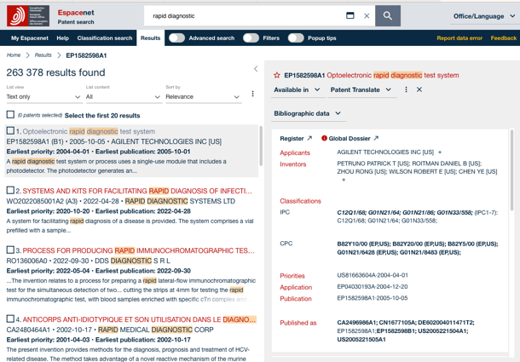
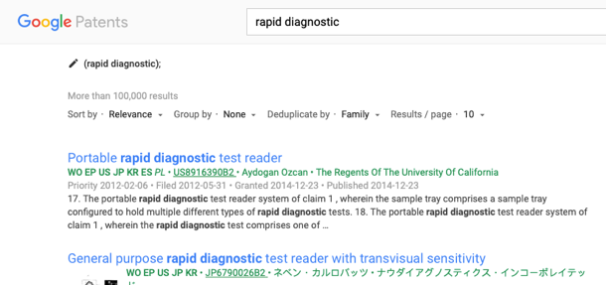
Methodology – Patent databases
Identify innovation
Who’s patenting in this space
  Companies/ researchers
“Hot” fields- How many patents and change over time
Comparing your idea/potential novelty/IP with
published IPRs
Free patent search tools – Espacenet, Patent lens, Google patents, WIPO Patentscope
Source of unpublished information
direct your own research, avoid reinventing the wheel, identify compounds, materials etc..
A knowledge of the scope of IP protection helps you avoid infringing other people’s IPRs, and may also give you an insight into where and when there may be business opportunities outside the limits of the protected IP.
Rapid diagnostics
Does not replace professional services! Go and talk to your technology transfer office - EARLY

Slide 34

Identifying a need/priority: UNSDGs
Aligning your research with the SDGs can be a powerful and practical way to showcase the societal impact of your research.
Connect your research to a larger purpose and audience while also enhancing its quality and visibility.
Practical resources to get you started:
https://sdgimpactassessmenttool.org/en-gb/articles/resources
Free tool that helps you identify relevant SDGs – based on description of your research
Identify Sustainability goals, sub goals and indicators related to your research
  https://unstats.un.org/sdgs/indicators/indicators-list/
  https://unstats.un.org/sdgs/indicators/Global-Indicator-Framework-after-2024-refinement-English.pdf
  https://sdgs.un.org/goals
To find out more about progress towards the SDGs in an EU context (not the developing world)
  https://ec.europa.eu/eurostat/en/web/products-catalogues/w/ks-05-24-072
Overview SDGs - https://libraryresources.unog.ch/sdgs

Slide 35
Identifying a need/priority: Engaging with policy makers
Gain insight into latest policy priorities and situate your research within key policy priorities
Access live policy papers, consultations, calls for evidence (there is a need identified)
  https://www.gov.uk/search/policy-papers-and-consultations?order=updated-newest
Meeting with policy makers helps researchers better understand the complexities and challenges associated with policy making and hear about the latest policy priorities https://www.cape.ac.uk/2024/02/08/academic-policy-meetings-benefits/
Explore case studies of researchers that have engaged with policy
  https://www.csap.cam.ac.uk/policy-fellowships/case-studies/
  https://www.cape.ac.uk/resources/?_category=4-case-study
Good introduction to ‘How can academics engage with policy making?’ https://www.plymouth.ac.uk/research/public-policy/how-can-academics-engage-with-policy-making
Policy engagement Toolkit from Future Leaders Fellowships(FLF) development Network: https://www.flfdevnet.com/policy-toolkit/

Slide 36
How to Identify the Right People to Speak With
Tools & Sources
Conference websites (speakers, sponsors)
Authors of articles, blogs, industry insights
Industry related news articles
Patent searches (inventor’s names– look up in LinkedIn)
LinkedIn (mutual connections, University alumni groups)
Community orgs, charities, advocacy groups
Social platforms: Bluesky ; X (formerly Twitter)
Local networking events or seminars
Connection Tips:
Ask for warm introductions where possible
Cold outreach works—if your reason is clear and relevant and shows why a conversation would be valuable for both sides.
Skills:
Networking, Communication with different audiences, pitching

Slide 37
Over to you
How skilled are your researchers at identifying/engaging stakeholders, incl users and beneficiaries of research outputs?
  5= Very skilled
  4= Somewhat skilled
  3=Neutral
  2=Somewhat skilled
  1=Not skilled at all
How well can your researchers articulate the broader value and potential impact of their work?
  5= Very well
  4= Somewhat well
  3=Neutral
  2=Somewhat well
  1=Not well at all
Please type your answers in the chat

Slide 38
2.Users and Beneficiaries
Research response (solution)
Research objectives
Competitive advantage
Users and Beneficiaries
Problem and context (Challenge)
Potential users and beneficiaries of the research are
those who are likely to be interested in or benefit from the proposed research both directly or indirectly.
It may be useful to think of beneficiaries as
‘users’ of the research outputs
“stakeholders” who will benefit in the longer term.
Key collaborators, partners and resources
Unique (value) proposition
v
Actions to achieve outcomes/impact/benefits and metrics
Outcomes/Benefits /Impact
Research output
Risks
Research expenses (Costs)
Funding streams (Income)
Be specific when describing users and beneficiaries
Skills:
Stakeholder identification &engagement
Market research/Qualitative research
Networking
Have you involved/consulted these in your planning ?– should you?
Have you arranged for their continuing involvement in the research process in an appropriate way?

Slide 39
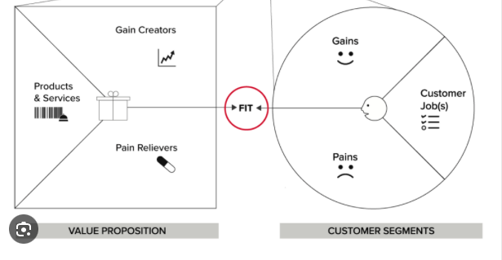
Tool: Beneficiary value proposition
Research response (solution)
Research objectives
Competitive advantage
Users and Beneficiaries
Problem and context (Challenge)
Key collaborators, partners and resources
Unique (value) proposition
v
Actions to achieve outcomes/impact/benefits and metrics
Outcomes/Benefits /Impact
Research output
Risks
Research expenses (Costs)
Funding streams (Income)
Research outputs
Identify pains and gains for each of the identified user/beneficiary groups relevant to your research
Users/
beneficiaries
Job(s)
Connect your research output & benefits to users/beneficiaries problems!
USER/BENEFICIARY SEGMENTS
Source: Adapted from Stratagyzer Customer Value proposition, https://www.strategyzer.com/library/the-value-proposition-canvas

Slide 40
3.Outcomes and Impact
Research response (solution)
Research objectives
Competitive advantage
Users and Beneficiaries
Problem and context (Challenge)
Key collaborators, partners and resources
Unique (value) proposition
v
Actions to achieve outcomes/impact/benefits and metrics
Outcomes/Impact
Research output
Risks
Research expenses (Costs)
Funding streams (Income)
Impact | The changes you hope to see over the long term
Outcomes | What you expect and want to accomplish with the project - short-term or medium-term effects of your research outputs
Start with the end (Impact) in mind
Identify pathway(s)/route(s) to impact e.g
Through policy engagement, Industry KT, commercialization, engaging schools, specific societal groups etc
Outputs | The tangible work products of the programme’s activities. Deliverables – (see outputs box)
Activities | Research activities, processes, tools, meetings, training
Identify clear logical phases and actions you (and collaborators or stakeholders) need to take to achieve the outcomes and impact

Slide 41
4. Research response
Research response (solution)
Research objectives
Competitive advantage
Users and Beneficiaries
Problem and context (Challenge)
Key collaborators, partners and resources
Unique (value) proposition
Highlight the aims of your research and how they address the problem you have identified (1)
What is novel in your research/approach?
Consider responsible research and innovation (RRI) - Public funders of research have the responsibility for creating value for society in an ethical and responsible way.
Consider ethical issues within the research:
Have you involved/consulted beneficiaries/stakeholders in your planning – should you?
Have you arranged for their continuing involvement in the research process in an appropriate way?
What is your data management plan?
v
Actions to achieve outcomes/impact/benefits and metrics
Outcomes//Impact
Research output
Risks
Research expenses (Costs)
Funding streams (Income)
Signpost your researchers to the policies, resources and training at your Institute
RRI
Research ethics
Research Integrity
Data Management

Slide 42
5. Research objectives & work plan
Research response (solution)
Research objectives
Competitive advantage
Users and Beneficiaries
Problem and context (Challenge)
Key collaborators, partners and resources
Unique (value) proposition
Looking at your research aims, what are the objectives that will help you achieve those aims ?
  Make them SMART (specific, measurable, achievable, realistic, time constrained (when they need to be achieved).
v
Actions to achieve outcomes/impact/benefits and metrics
Outcomes/Benefits /Impact
Research output
Risks
Research expenses (Costs)
Funding streams (Income)
Consider the following when describing your objectives/actions
  Have you provided a well thought out research design in which there is a reasoned explanation of how it addresses the challenge articulated?
  Are you being realistic about these? What will your research design allow you to say in the interpretation of anticipated results?
  Are you satisfied that you have fully defended your chosen research design and made it clear why others are not appropriate?
    Clearly articulate how your research differs/is better from competing approaches to solve the problems
  Are you using the most relevant approach and the most appropriate methods? How will these relate to and deliver the objectives?
  Have you given a full and detailed description of the proposed research methods? Is there any innovation in the methodology you are planning to use? Or are you using established methods innovatively?

Slide 43
6. Research Outputs
Research response (solution)
Research objectives
Competitive advantage
Users and Beneficiaries
Problem and context (Challenge)
Key collaborators, partners and resources
Unique (value) proposition
What outputs will you generate? consider
v
Actions to achieve outcomes/impact/benefits and metrics
Outcomes/Benefits /Impact
Research output
Risks
Research expenses (Costs)
Funding streams (Income)
  Publications (articles, books, monographs etc)
  Website
  Give a talk(s) at conferences (which ones?)
  Data sets
  New theory
  Creation of research material
  New research method
  An invention
  Creation of Software
  Creation of reagents
  IP
  Training sessions
  A new collaboration or partner
  A public engagement event
  Events
  workshops
  Exhibition
  Other …
Remember :
Choose outputs that will enable you to achieve the outcomes you listed and that will contribute to the subsequent impact
Signpost your researchers to resources and training related to the creation of selected outputs

Slide 44
7. Actions to achieve outcomes/Impact
Research response (solution)
Research objectives
Competitive advantage
Users and Beneficiaries
Problem and context (Challenge)
Key collaborators, partners and resources
Unique (value) proposition
Have you outlined appropriate and creative plans (throughout the project) to achieve the outcomes and impact/benefits identified?
It is important to devote sufficient resource (people and costs) to activities which will contribute to impact generation and impact evaluation
Consider:
Will stakeholders be actively involved in the research?
v
Actions to achieve outcomes/impact/benefits and metrics
Outcomes/Benefits /Impact
Research output
Risks
Research expenses (Costs)
Funding streams (Income)
​What evidence could be gathered of the potential outcomes and impact/benefits achieved?
How will you collect and store the evidence for future reporting such as REF (UK)?” (Include knowledge exchange with industry; researcher
development and training)
How will you make stakeholders aware of the research and its outputs?
Impact activity application and exploitation - How could the results of the research be applied in practice?
Impact on your or your team’s development throughout the project
What are the key decision points and events for impact activities?

Slide 45
8. Key collaborators, partners, resources
Research response (solution)
Research objectives
Competitive advantage
Users and Beneficiaries
Problem and context (Challenge)
Key collaborators, partners and resources
Unique (value) proposition
List the collaborators, partners and resources you require to achieve your research objectives, including all the outputs/benefits/impact you want/hope to achieve (identified in box 3)
Consider:
Are there specific partners/collaborators that are needed to carry out the research and/or will increase the strength of the research (and give you an edge over similar research? )
  specific technical expertise
  specific equipment ,
  end users of your research,
  organisations that hold data that you need access to etc..),
  patient groups,
  policy maker,
  service provider
v
Outcomes/Benefits /Impact
Research output
Risks
Actions to achieve outcomes/impact/benefits and metrics
Research expenses (Costs)
Funding streams (Income)
How will you demonstrate that your host organisation:
has the appropriate facilities
is the appropriate team
is committed to support you effectively
can give you access to relevant networks
will add value to the investment from the funder?

Slide 46
8. Key collaborators, partners, resources
Research response (solution)
Research objectives
Competitive advantage
Users and Beneficiaries
Problem and context (Challenge)
Key collaborators, partners and resources
Unique (value) proposition
v
Outcomes/Benefits /Impact
Resources include:
Research output
Risks
Actions to achieve outcomes/impact/benefits and metrics
Research expenses (Costs)
Funding streams (Income)
Staff with the skills and competencies required (you and others) to carry out the research and to achieve the output/outcomes/impact.
Are you planning communication, collaboration, and research application and exploitation activities? What skills are required? If you are planning a public engagement event – will you need to pay for a video creation team to document and reach a wider audience?
Do you want a market research report done to scope the size of your commercialisation opportunity? – requires funds
Materials, equipment, IP (already existing or intention to apply for IP), do you need to license IP ?
Include in this section as appropriate for the funding scheme (research project or personal fellowship) any personal and staff development opportunities – this can be courses/opportunities to develop technical skills, or professional and career development opportunities for you and/or your team.
Consider ED&I in plans for recruitment and development of resources
Advice and support to identify what resources are required (and associated costs) is available from your departmental/School Research or KT Facilitators, Technology transfer offices, the Public engagement team, Policy units. Reach out to them early, they will be more than happy to support/advise you.
https://www.flfdevnet.com/recruitment-toolkit/

Slide 47

9. Competitive advantage
Research response (solution)
Research objectives
Competitive advantage
Users and Beneficiaries
Problem and context (Challenge)
Key collaborators, partners and resources
Unique (value) proposition
v
Outcomes/Benefits /Impact
Research output
Risks
Actions to achieve outcomes/impact/benefits and metrics
Have you justified why you and/or your team are the best team to undertake the proposed research? And why they should fund you?
Research expenses (Costs)
Funding streams (Income)
What is your/your team's distinctive or advantageous position over others?
What is your edge that enhances the likelihood of carrying out the research and impact compared to other researchers/teams?

Slide 48
10. Research expenses (costs)
Research response (solution)
Research objectives
Competitive advantage
Users and Beneficiaries
Problem and context (Challenge)
Key collaborators, partners and resources
Unique (value) proposition
List categories of costs/expenses associated with carrying out the research and all other activities to achieve the outputs and impact
To cost your project, consider:
salaries,
capital equipment cost or rent,
institute overheads,
travel; conference fees,
IP fees?,
publication,
Events organization
Creating video, audio resources
technical and professional training programme costs,
website development,
evaluator costs,
payment for study participants, animal care costs, etc.
v
Outcomes/Benefits /Impact
Research output
Risks
Actions to achieve outcomes/impact/benefits and metrics
Research expenses (Costs)
Funding streams (Income)
Advice and support on costs is available from your department
/School Research or KT Facilitators, Technology transfer office, the Public engagement team, Policy units.
Reach out to them early, they will be more than happy to support/advise you.

Slide 49
11. Funding streams (income)
Research response (solution)
Research objectives
Competitive advantage
Users and Beneficiaries
Problem and context (Challenge)
Key collaborators, partners and resources
Unique (value) proposition
Treat every funder and every scheme as particular, unique, and contingent.
Get to know what a funder’s mission is:
  Why does this funder exist?
  Where does their money come from?
  What factors influence the kinds of projects they want to fund, e.g. incremental vs novel, safe vs risky, academic impact vs public good?
Don’t just read the guidance notes for your scheme. Read everything, incl. news, blogs, social media, etc.
Study titles and lay summaries of previously funded projects and people – identify themes, keywords, types of impact.
v
Outcomes/Benefits /Impact
Research output
Risks
Actions to achieve outcomes/impact/benefits and metrics
Research expenses (Costs)
Funding streams (Income)
Project - funder FIT
Research/Knowledge Transfer/impact Facilitators can scan your research canvas and not only help you identify appropriate funders but also highlight what is still missing from your proposal before you start writing a draft proposal – much quicker and efficient for both the research facilitators and you
Useful guide: Getting research funded : five essential rules for early career researchers / Tseen Khoo, Phil Ward and Jonathan O'Donnell.
https://www.ukri.org/apply-for-funding/how-we-make-decisions/

Slide 50
12. Risks
Research response (solution)
Research objectives
Competitive advantage
Users and Beneficiaries
Problem and context (Challenge)
Key collaborators, partners and resources
Unique (value) proposition
Think about the key risks associated with the proposed research and detail the risk mitigation measures
How do you prevent or address these/what are the mitigation plans?
Consider risks associated with:
  Scientific and technical
  Data
  People – inc duty of care
  Political
  Financial
  Reputational
  Risks of non-completion – plan B etc.
v
Outcomes/Benefits /Impact
Research output
Risks
Actions to achieve outcomes/impact/benefits and metrics
Research expenses (Costs)
Funding streams (Income)
Signpost your researchers to resources and training related to Managing risk in research projects

Slide 51
13. Unique value proposition
Research response (solution)
Research objectives
Competitive advantage
Users and Beneficiaries
Problem and context (Challenge)
Key collaborators, partners and resources
Unique (value) proposition
A persuasive, concise introduction that provides the listener/funder with
a solid idea of the purpose and significance/value of your research and to whom;
what you will do and how – what is novel?
what’s unique about you, your team, your research to realise these benefits compared to others
(And therefore - why you should be funded)
v
Outcomes/Benefits /Impact
Research output
Risks
Actions to achieve outcomes/impact/benefits and metrics
Research expenses (Costs)
Funding streams (Income)
Funders and reviewers see plenty of applications!
Make yours stand out and is easy to understand for experts and non experts
Signpost your researchers to resources and training on communication, pitching, storytelling
It takes time to craft a compelling research value proposition !!!

Slide 52
Creating a personal pitch
How to introduce yourself at Networking events

Slide 53
Personal pitch example - networking
My name is X, and I work at Y. My research is addressing one of the most important health threats to humans – bacterial infections that increasingly can’t be treated with current antibiotics due to bacteria developing resistance against antibiotic drugs.This multidrug resistance problem was responsible for over 1 million global deaths in 2019 and by 2050 is projected to result in over 8 million deaths per year globally and 1 trillion US $ additional healthcare costs.
Our research focuses on studying one of the least understood mechanisms that enable bacteria to spread resistance as a promising route for addressing antibiotic resistance, By developing strategic partnerships with industry leaders and academic institutions, we aim to accelerate the translation of our research findings into practical applications to address antibiotic resistance. Sitting alongside responsible prescribing and diagnostic tests, these potential new drugs will help reduce the health threat from antibiotic resistant infections. I’m keen to connect with Research Strategy Advisor for Innovation in the Fleming Initiative and well as with Research leads on antimicrobial resistance in GSK, Pfizer and Johnson and Johnson, who are the leaders in this field.
a wide range of cutting-edge, complementary techniques including molecular genetics, microscopy, biochemical and structural approaches
Name and credentials
Context/Problem/impact of problem
Solution/research/
Outcomes/Impact
Call to action? Need?

Slide 54
Personal pitch – Example 2- networking
My name is X, and I work at Y. In the UK, there has been a gradual decline in numbers of students choosing languages at GCSE, A level and in higher education. This lack in language skills could be costing UK Businesses up to £48 billion each year.
My research is raising awareness of the value of languages to key social, political and economic issues of our time, and the benefits of speaking more than one language. We are taking two approaches – at policy level and through developing a UK first pop-up languages museum, with events designed to change public opinion by demonstrating the value and the benefits of language learning through fun activities, especially for young people. Through these approaches, we aim to increase uptake in number of students choosing languages.
I’m interested in connecting with heads of education or outreach at regional museums around UK to host one of our pop us.
Name and credentials
Context/Problem/impact of problem
Solution/research/
Impact
Call to action? Need?

