Slide 1
Career development - what do postdocs want and do PIs provide it?
Dr Rebecca Ehata
Careers & Employability Consultant for Researchers
Notes:
Mechanisms exist at the University of Sheffield (UoS) to encourage academic and research staff engagement with organisations outside academia, including knowledge exchange and consultancy
Anecdotal evidence indicated that fixed-term research staff (called ‘postdocs’ here) do not make use of Concordat-mandated professional and career development days, despite the availability of internal mechanisms to support this.

Slide 2
Review focused on:
Career development activity which links postdocs with external (non-academic) audience to align with:
The Researcher Development Concordat:
mandate to prepare for careers outside as well as within academia
Provision of 10 professional development days (12 at UoS)
Wider policy support for intersectoral mobility
The likely career trajectories of many postdocs
3 career development activity mechanisms: Knowledge Exchange (KE); consultancy; and secondments

Slide 3
How did we conduct the review?
Employed a postdoc to carry out the project (funded with research culture money), who
Reviewed relevant UoS policy and strategy documents
Conducted two (very similar) surveys of 1) postdoc and 2) PIs and line managers
Carried out informational interviews with ECR leads and professional services staff who support postdocs and PIs

Slide 4
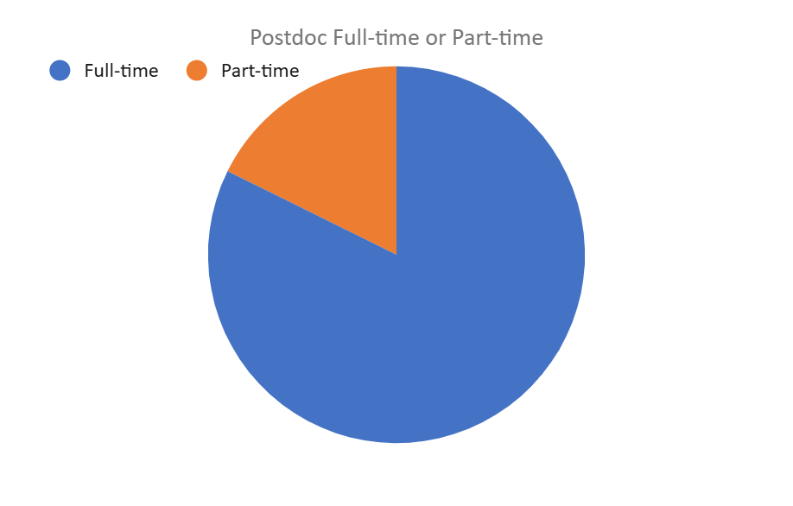
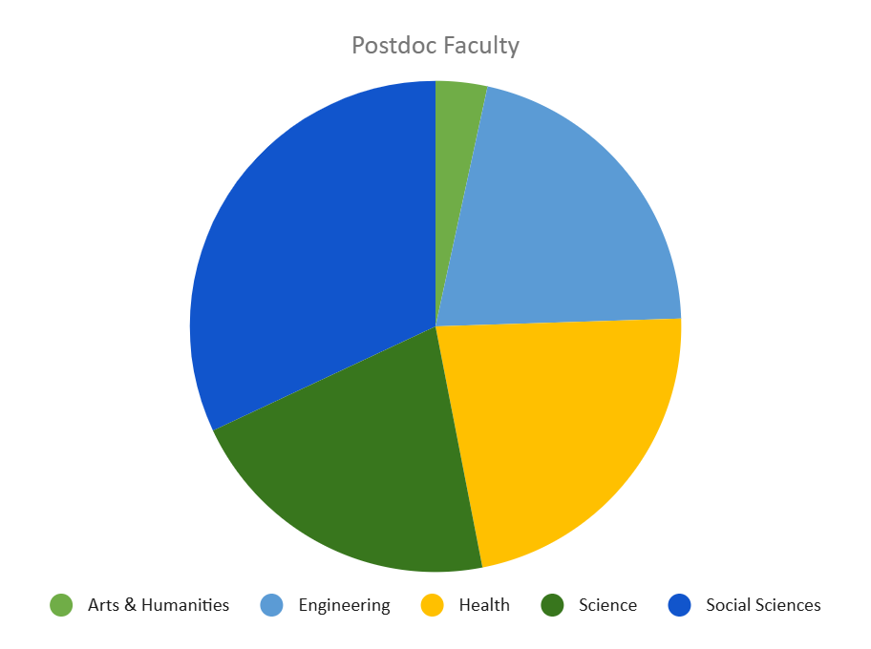
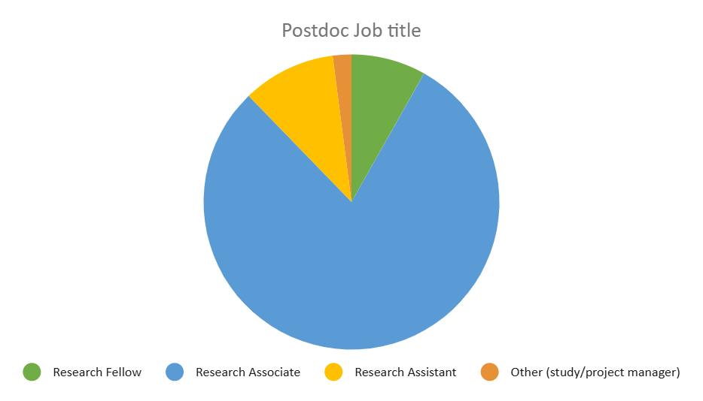
Survey demographics: postdoc respondents (n=147)
Notes:
Notes and thoughts
Faculties fairly well represented
A&H under-represented in comparison to other faculties (only 5 in total – although not a bad proportion in regards to A&H itself)

Slide 5
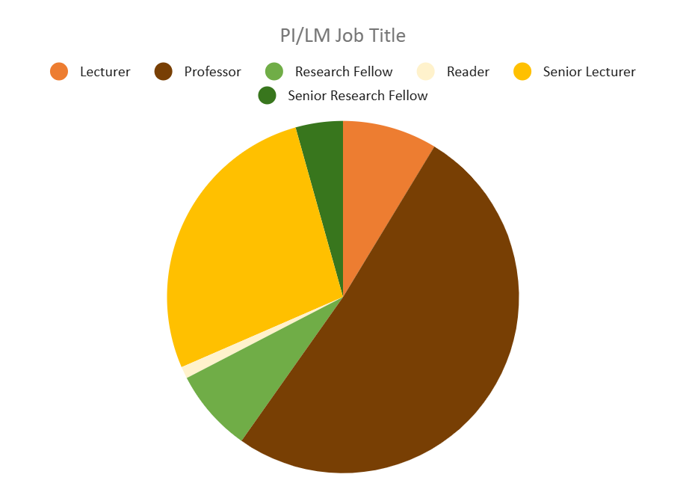
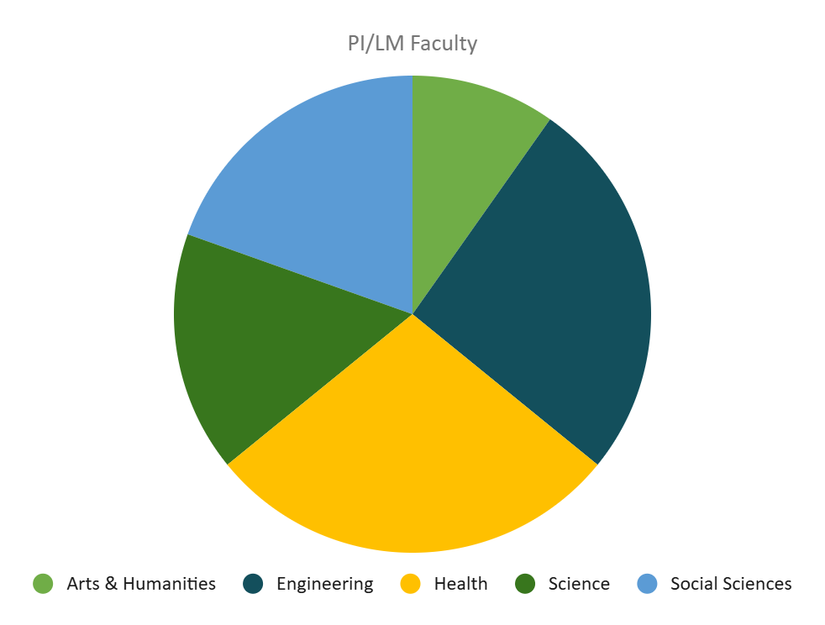
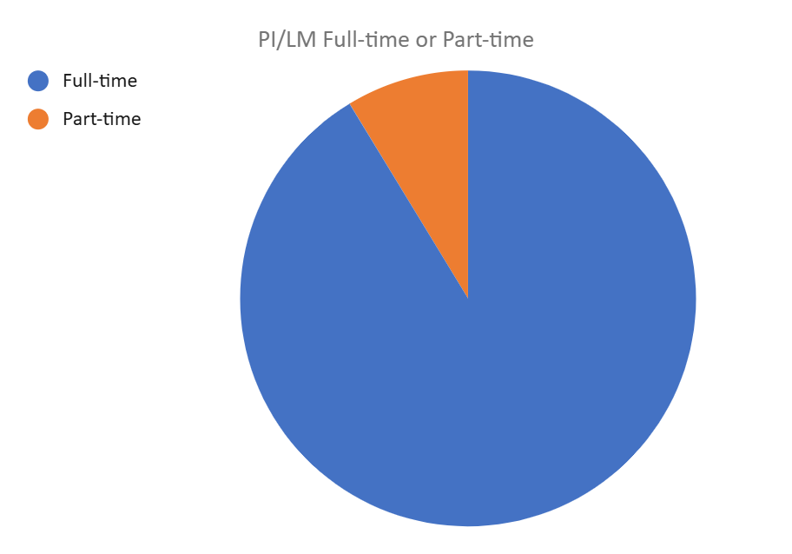
Survey demographics: PI/Line manager respondents (n=92)
Notes:
Notes and thoughts
Faculties fairly well represented
A&H FTRS under-represented in comparison to other faculties (only 5 in total – although not a bad proportion in regards to A&H itself)

Slide 6
Key topics of enquiry
Interest in non-academic career development opportunities
Awareness of university mechanisms and allocated development days
Reported levels of uptake
Challenges and barriers to uptake

Slide 7

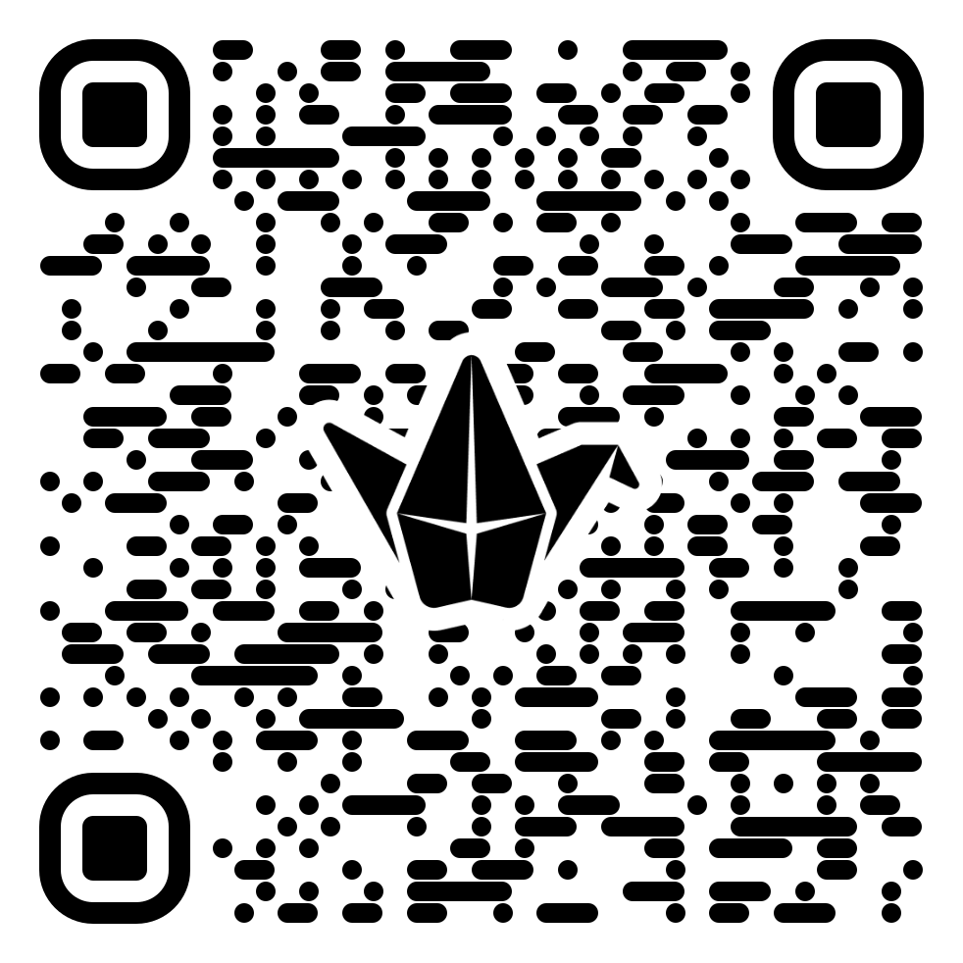
Padlet poll
How many postdocs in your institution WANT TO vs. ACTUALLY use one or more days per year on (non-academic) professional development activities of any kind?
https://padlet.com/thinkahead/postdoc-interest-vs-engagement-in-non-academic-career-develo-d8q79peo3negfkmq

Slide 8
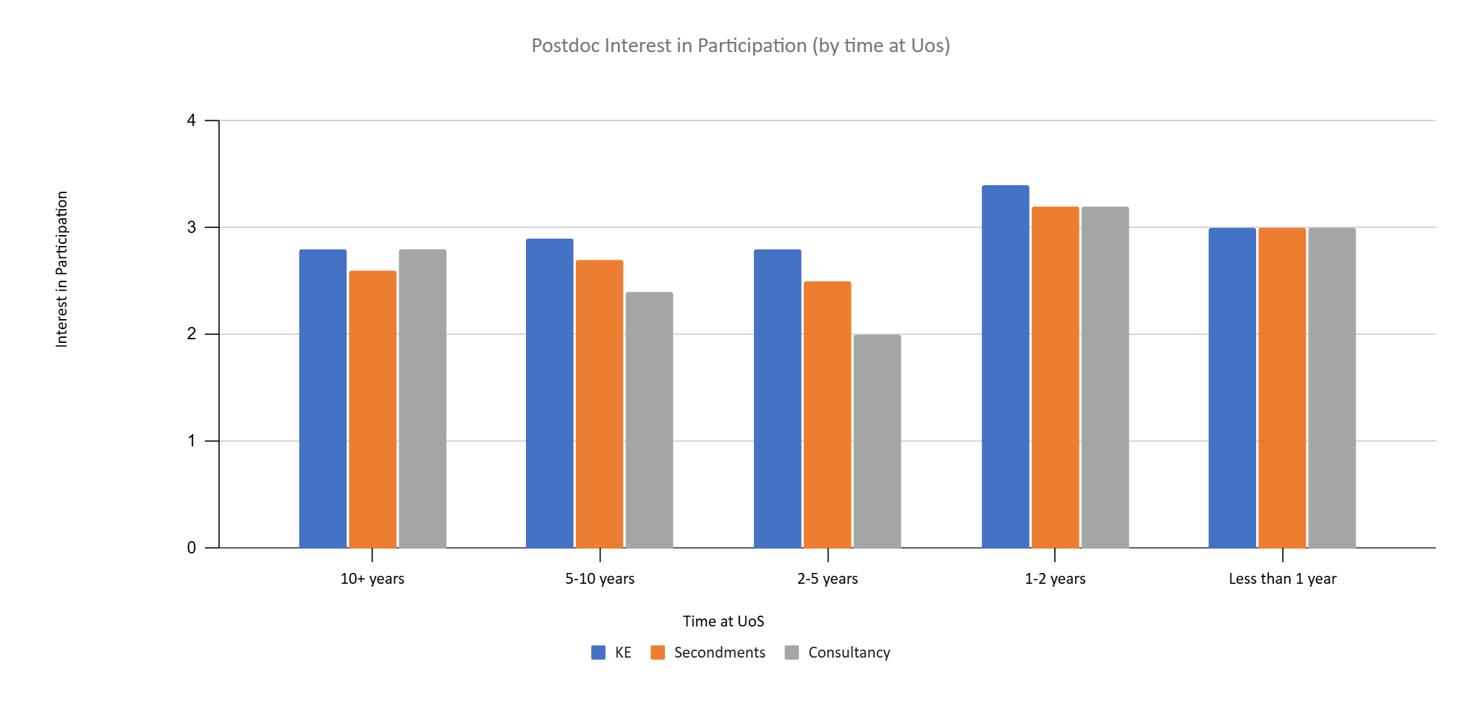
Do UoS postdocs want non-academic career development activity?
Score | Interest
0 | Don't want to participate
1 | Not very interested
2 | Only if convenient
3 | Fairly interested
4 | Very interested

Slide 9
How much time is nominally available for career development?
1 day/ month
On average, both PIs and postdocs stated that it is feasible for postdocs to spend one day a month on career development activity
(The PI score was slightly higher than the postdoc score.)

Slide 10
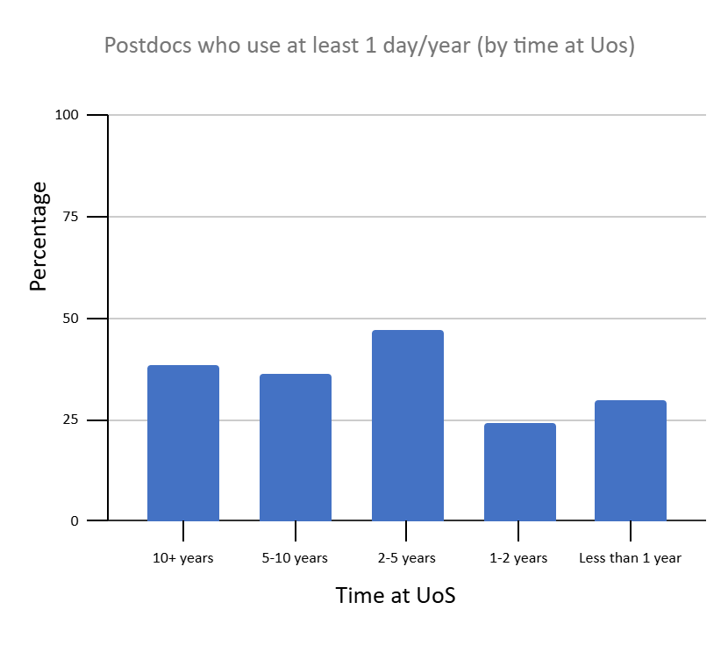
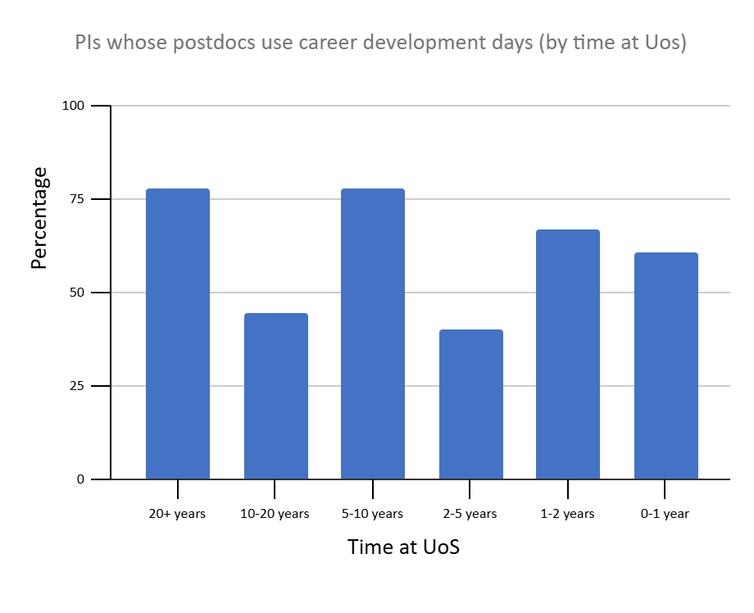
How many days are actually used for career development?

Slide 11
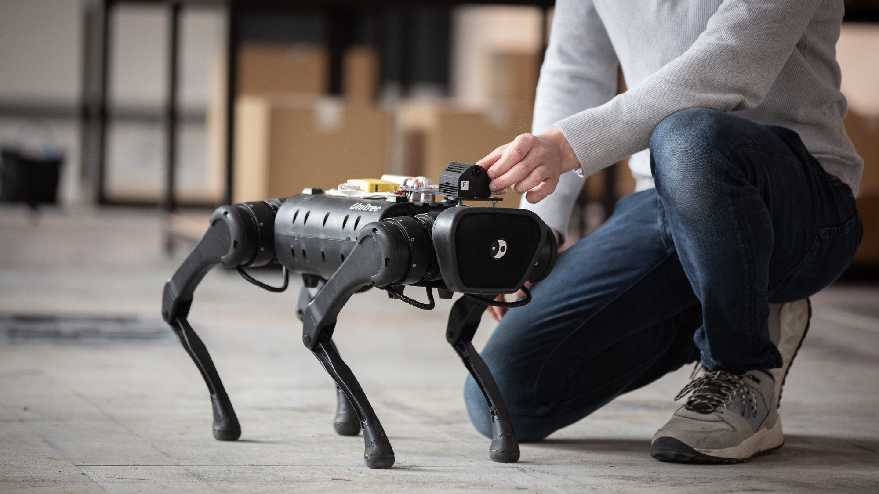
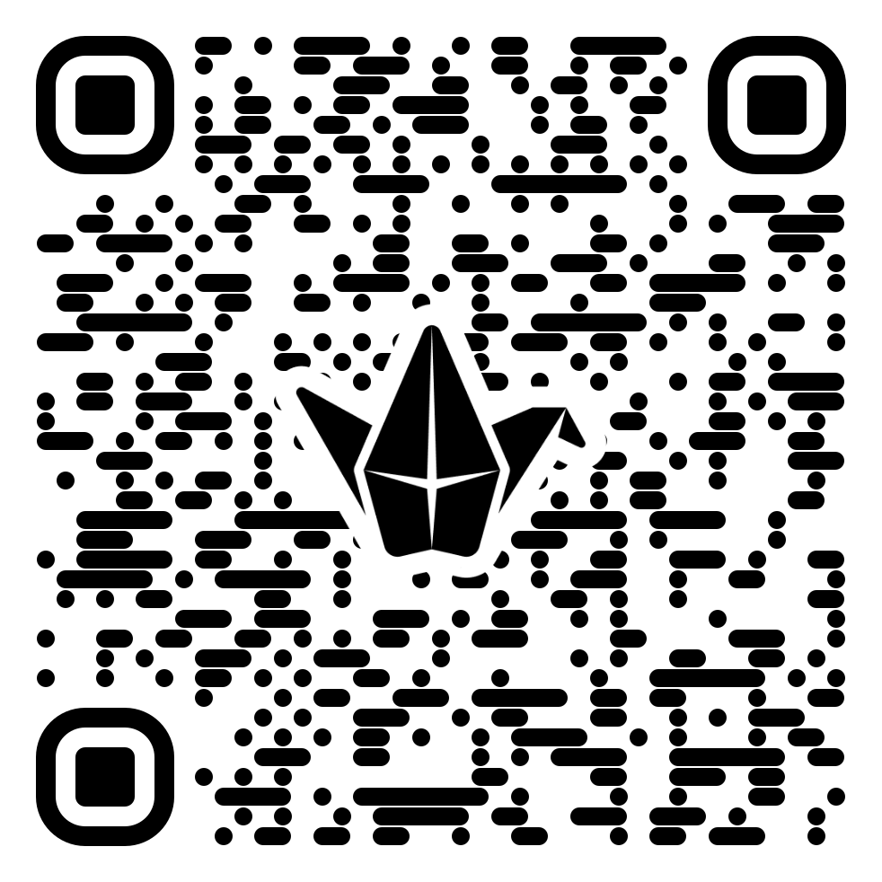
Brainstorm:
What barriers prevent postdocs at your institution from carrying out career development activities?
Add your thoughts to the Padlet sheet:
https://padlet.com/thinkahead/what-barriers-prevent-postdocs-in-your-institution-from-unde-ab30dyfyzi3hjiog

Slide 12

Why don’t postdocs use their professional development days?
“I've been told to use annual leave for professional/career
development activities, which is what I do.”
“There have been
issues in our department where PIs state that the needs of the funder come before allowing
for days of personal development.”
“I'm working on a EU-funded project and I haven't been told that I'm allowed to take 12 days of PD per year.”
“I’m aware of some of my colleagues using
[development days] but it feels very ‘under the carpet.’”

Slide 13
Barriers identified by postdocs: time
“ECRs lack time [for career development] due to consideration of where their next contract is coming from – they already have to work extra to fill out a CV to get the next position.”
“The lack of job security means time has to be spent maximising the project output so I can then try and find another job afterwards using the experience.”
“I would be extremely interested in these opportunities! but very much needed to hear at the beginning of my contract as will take some time to organise; I am nearing the last 3 months of my contract.”

Slide 14
Barriers identified by postdocs: knowledge
“I had little awareness of secondments before doing my own, and even now, not sure of the workings – my PI suggested it after money came in.”
“I know about consultancy for academics but not for ECRs”
“Many ECRs don’t know where to start with process of KE - who to contact, how to market themselves.”
“Lack of advertising for where to find these [KE] reps and related information, and hard to find information online when they do search without a link.”
“Processes are all a bit vague - hard to know where to start.”

Slide 15
Barriers identified by postdocs: confidence
“Junior ECRs may not have confidence to approach PI with ideas for them to engage with external organisations.”
“It usually feels like the government doesn’t value Arts & Humanities research, so why should industry?”
“ECR engagement is good when encouraged by their PI or director of research (there’s a big difference between fully funded ECRs and those who are less secure).”

Slide 16
Barriers identified by postdocs: impact on career?
“[ECRS have] concerns with working with external organisations and media appearances – of their words being twisted; [they] would rather have a lesser profile than risk being taken out of context.”
“Going into industry is seen [by some ECRs] as a ‘one way route’, whereas people return from industry with additional skills and connections.”
“It doesn’t seem to register with many ECRs that working with externals can lead to opportunities; they are usually too focused on achieving the next tangible [academic] goal with a sense of urgency.”

Slide 17
Barriers identified by postdocs: life challenges
“… juggling research and childcare is a huge challenge. Anything "extra" and "optional" like career development gets completely pushed off my priority list. … unless they are paid for and extra days are *added to my contract*, it's just one more thing I'm expected to magically find time for, that I won't be able to do.”
“ juggling a full-time research contract with childcare, job hunting for the next contract, while manoeuvring the ever-changing field of visa requirements for international (skilled) workers.”

Slide 18
Do postdocs think PIs support non-academic career development activity?
Perceived support by PIs for postdoc non-academic career development
Results presented as an average score ± standard deviation. Scores equate to the following:
0 = Not supportive
1 = Yes, if planned out or postdoc is enthusiastic
2 = Yes, unconditionally.

Slide 19
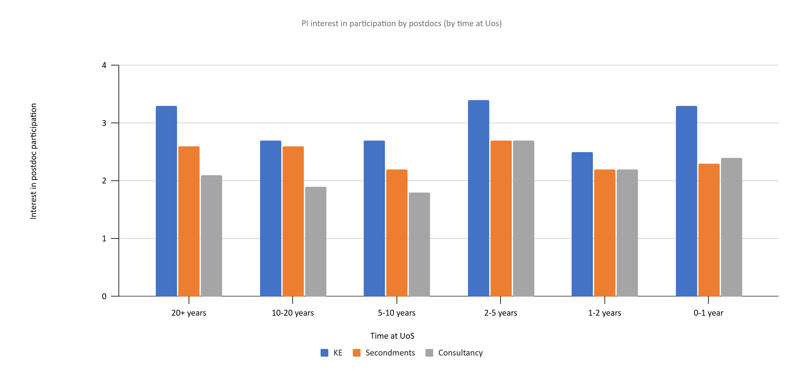
Do PIs express an interest in having their postdocs participate in non-academic career development activity?
Score | Interest
0 | Don't want them to participate
1 | Not very interested
2 | Only if convenient
3 | Fairly interested
4 | Very interested

Slide 20
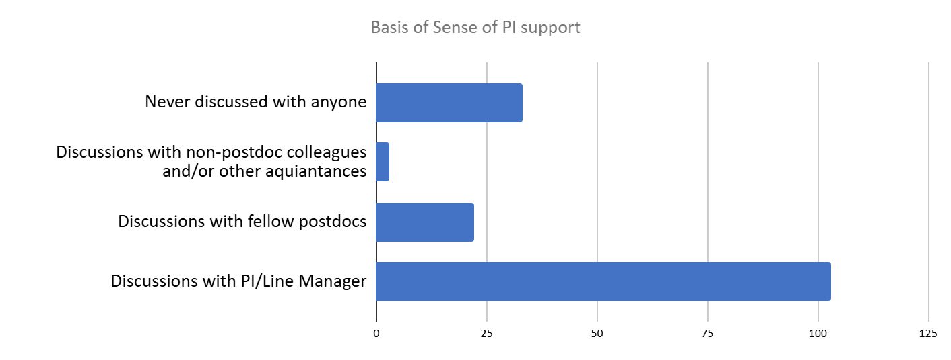
How do postdocs know if their PIs support career development activity?
22.4 % of postdoc respondents reported never having discussed career development activities with their PI
78% of PIs surveyed reported that they raised the topic of engaging in KE activity in conversations with their FTRS

Slide 21
Barriers identified by PIs: time / funders
“Time *isn't* available; she's paid 100% on the grant.”
“How is this [career development activity] allocated in a costing model?”
“development is often done in their own time, because TUOS fills people's "development" time with thoughtless mandatory training … to the tune of 12 days or more. At the end of which FTRS still have to do the job for which they're actually funded.”

Slide 22
Barriers identified by PIs: lack of institutional support
“I just sent my postdoc overseas to a collaborator for three months to learn a new technique. We weren't able to find useful information within the uni about what forms to fill out and how to ship our materials.”
“I've tried to involve my postdocs in consultancy collaborations but there was not a way for the postdoc to benefit financially from the experience and I don't understand why this should not be the case.”
“[The university] does not provide any central funding for this activity as far as I am aware, which is a problem when salary costs are dependent on income-generating activities.”

Slide 23
Barriers identified by PIs: lack of institutional clarity / flexibility
“[It] depends how you define 'career development activities', because these might be going to meet an alternative community group that could offer them future employment etc, not what the University would define as career development.”
“When I've employed FTRS in the past they have felt that the services on offer to them presume they are looking for a research career when in practice they are community developers or project managers who are working for a while in a research context … this form of hybrid professional is less well served than those who are on a research-related career development trajectory.”

Slide 24
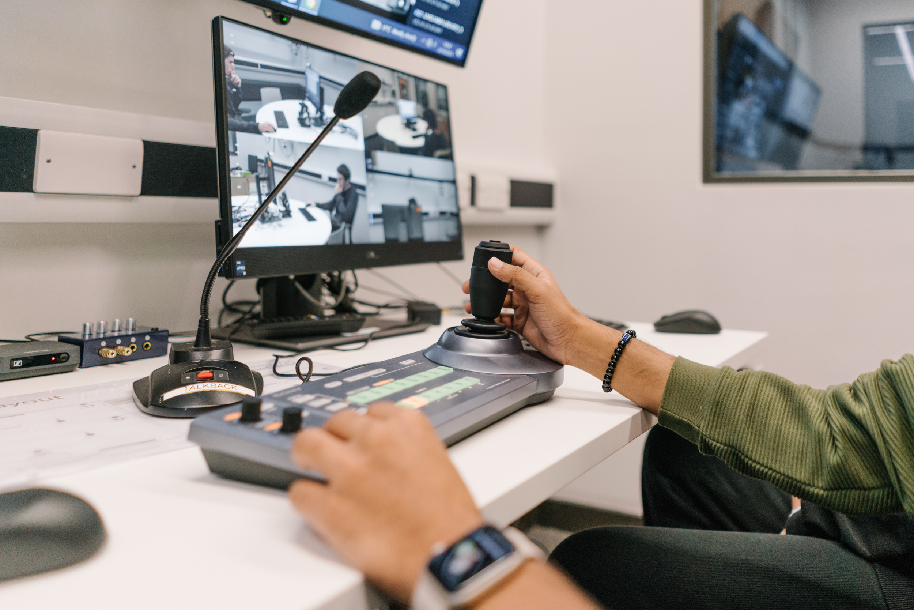
Breakout groups: good practice + next steps
In your group, please discuss the following questions (and be ready to report back):
What good practice in supporting postdoc career development do you know of (in your institution or elsewhere)?
What one action should your institution take first to increase postdoc career development activity?
If you can’t join a breakout group, please stay in the main room and discuss with others who remain there.

Slide 25
UoS work to remove postdoc career development barriers
Raising awareness of career development days (and the wider Concordat) – among both postdocs and PIs
Raising awareness of mechanisms such as KE, and postdoc eligibility for these – among both postdocs and PIs
Clarifying what counts as career development at the university
Creating a database of case studies of postdoc career development
Getting explicit support for postdoc career development activity from research funders
Incentivising PIs to encourage uptake of career development activities by the postdocs they line manage

Slide 26
Reflection + action
Which of the barriers identified in our review most closely matches the experience of postdoc career development at your institution? (Choose one)
What can you / your institution do to begin dismantling that barrier immediately?

Slide 27
Get in touch: r.k.ehata@sheffield.ac.uk
www.sheffield.ac.uk

