Slide 2





Prosper Exchange - Launch
26 June 2025
Led by
Supported by
An Academy project

Slide 3
Session objectives
Learn more about the purpose of the Prosper Exchange and plans for pilot phase.
Understand how you can access support from the Prosper team in exchange for resources you can share to contribute to the future of Prosper.
Through discussions with peers, share practice around postdoc career development.
By engaging with the Prosper Exchange pilot and sharing your views, play an active role in shaping the future of Prosper.

Slide 4
What is the Prosper Exchange?
A framework for sustaining future impact of Prosper, through sharing practice. The Prosper Exchange aims to keep Prosper free-to-use and relevant.
It presents an opportunity for us to explore ways of working together and to share practice and resources through a vibrant community of practice.
To access enhanced support from the Prosper team, you will need to engage with the Prosper Exchange but it does not change how you currently use what is available on the Portal.
Today is the launch of a pilot period, which will run to March 2026. The Prosper Exchange will be finalised and run business as usual from June 2026. Prosper’s UKRI funding ends August 2026. After this date, the team will be smaller and funded by University of Liverpool.
During the pilot phase, we’ll be refining and developing what we show you today as experience with the process grows. To make it fit for purpose in the long-run, we need user feedback!

Slide 5
How does the Exchange work?
Prosper can offer: | Examples of what an institution might exchange:
Data and reporting about registered user activity at your institution | A testimonial from you or a postdoc at your institution about Prosper
Gap analysis | An employer to deliver one of Prosper’s employer insight sessions
Guidance on recruiting or running a cohort | Adding resources, such as a session developed for postdocs at your institution to the Prosper Portal
Train-the-trainer | A PI Network session and accompanying resource which can be uploaded to the Portal.
Session facilitation | A detailed case study about Prosper at your institution

Slide 6
The Prosper Exchange in practice https://prosper.liverpool.ac.uk/institution-resources/the-prosper-exchange/

Slide 7
Over to you – questions?

Slide 8
Questions we’ve been asked so far…
How do you assess what is a fair exchange?
How can this help HEIs with less resources?
Will there be guidance and templates to support the exchange?
I will be using Prosper in Mode 1 – is this enough for case study?
Can I use the Exchange for guidance on using Prosper with non-postdocs?

Slide 9
Prosper community of practice – break-out rooms
You will now go into beak-out rooms to discuss use of Prosper with peers.
Ideas for discussion themes include:
Raising awareness of Prosper amongst postdocs and PIs at your institution
Encouraging self-directed use of Prosper resources
Collaborating across institutions
General Prosper chat
20 minutes for discussions.

Slide 10

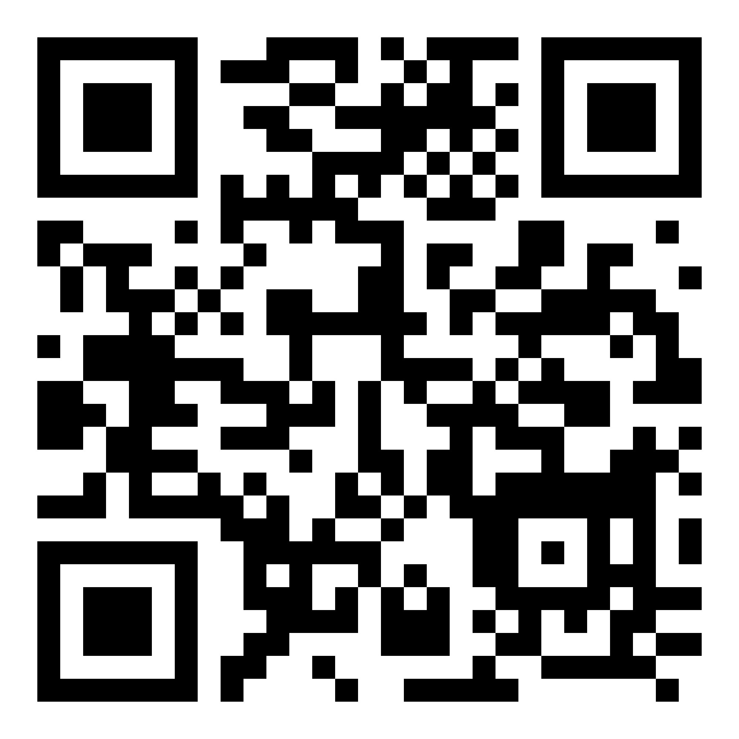

Share your thoughts:
Email prosper.postdoc@liverpool.ac.uk
Led by
Supported by
An Academy project
Except where otherwise noted, this work is licensed under the Creative Commons Attribution-NonCommercial-ShareAlike 4.0 International License. To view a copy of this license, https://creativecommons.org/licenses/by-nc-sa/4.0/

