Slide 1

Skills inventory
Except where otherwise noted, this work is licensed under the Creative Commons Attribution-NonCommercial-ShareAlike 4.0 International License. To view a copy of this license, https://creativecommons.org/licenses/by-nc-sa/4.0/

Slide 2
Section outcomes
Understand what a skills inventory is and its importance
Be able to sign-post your postdoc to practical ways to unpack their skills
Prompt questions for you to consider

Slide 3
Why unpack a ‘researcher’ into skills?

Slide 4
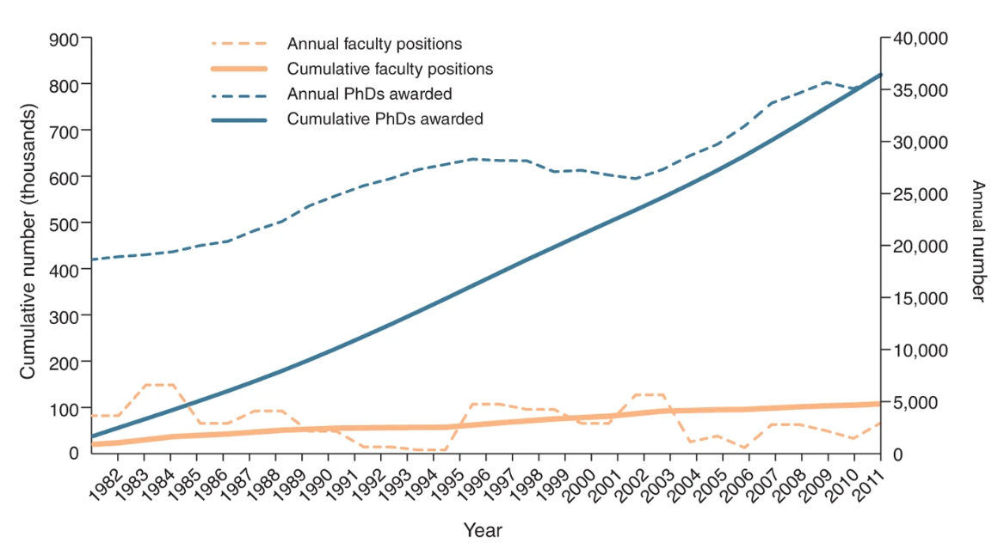
Setting the scene –postdocs need to consider all their career options
‘Since 1982, almost 800,000 PhDs were awarded in science and engineering (S&E) fields, whereas only about 100,000 academic faculty positions were created in those fields within the same time frame. The number of S&E PhDs awarded annually has also increased over this time frames, from ~ 19,000 in 1982 to ~36,000 in 2011. The number of faculty positions created each year, however, has not changed, with roughly 3,000 new positions created annually’
Figure from Schillebeeckx, M., Maricque, B. & Lewis, C. 2013. The missing piece to changing the university culture. Nature Biotechnology, 31, 938-941.

Slide 5
What is a skills inventory?
A comprehensive document (or list) containing all of an individuals educational qualifications and professional skills.
This should also capture professional abilities and attributes.
Also referred to as a ‘personal skills audit’

Slide 6
How to unpack a ‘researcher’ into skills?

Slide 7
How to unpack a ‘researcher’ into skills?
Time
Research output
Real-time skill spotting

Slide 8
How to unpack a ‘researcher’ into skills?
Time
Research output
Real-time skill spotting

Slide 9
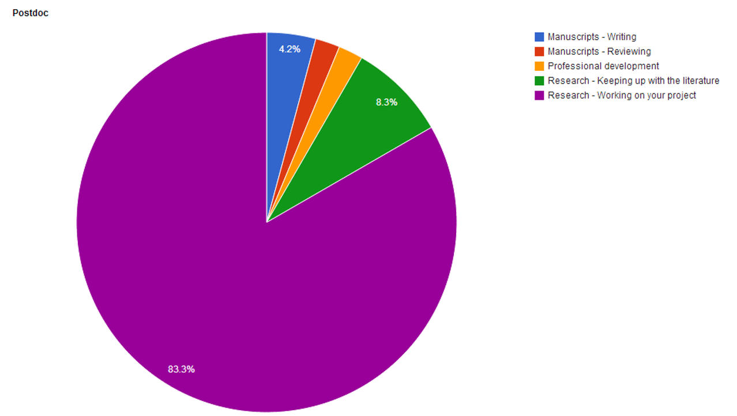
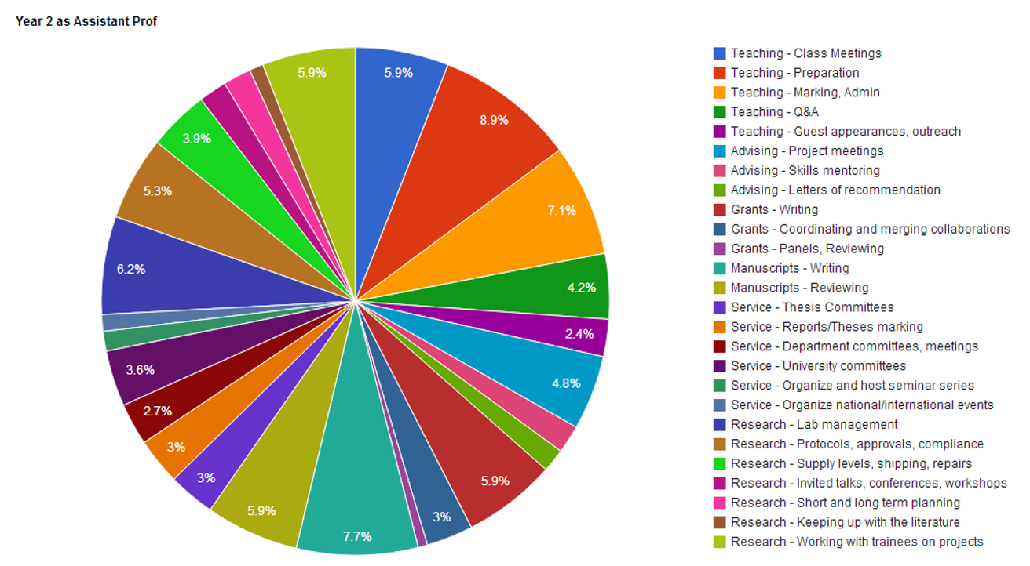
What do you spend your time doing?
Postdoc
Year 2 as assistant professor
Images reproduced from ‘So,you want to be an academic?’ by Matthijs van Der Meer http://www.vandermeerlab.org/MvdM_SoYouWantToBeAnAcademic.pdf (accessed 24/02/2022)

Slide 10
Main tasks
Sub tasks
Sub sub tasks
Research
Teaching
Training/
supervision

Slide 11
Main tasks
Sub tasks
Sub sub tasks
Communication
Attending conferences
Research
Leadership
Teaching
Administration
People management
Training/
supervision
Lesson planning
Procurement of materials
Risk/safety assessments
Evaluation
Reflection on practice
Technical skills/knowledge (disciplinary niche specific)
Data collection/acquisition
Data processing
Analytica skills
Problem solving
Establish and maintain collaboration/s

Slide 12
Main tasks
Sub tasks
Sub sub tasks
Communication
Conflict resolution
Outreach/public engagement
Attending conferences
Research
Writing –papers/reviews/book chapters
Leadership
Keeping up with the literature
Teaching
Social media
Administration
Stakeholder engagement
People management
Narrative creation
Training/
supervision
Lesson planning
Procurement of materials
Risk/safety assessments
Evaluation
Reflection on practice
Financial management/budgeting
Time management
Negotiation
Networking
Technical skills/knowledge (disciplinary niche specific)
Data collection/acquisition
Data processing
Analytica skills
Problem solving
Establish and maintain collaboration/s
Setting, preparing for and attending project meetings
Reviewing students project progress
Reviewing students presentations/teaching presentation style
Reviewing students data analysis/acquisition of area specific technical skills and/or jargon
Reviewing students written work/written output

Slide 13
Main tasks
Sub tasks
Sub sub tasks
Communication
Conflict resolution
Managing communications and interpersonal colleague relationships – above, below and peer
Outreach/public engagement
Attending conferences
Public speaking- style and info tailored to specific audience
Research
Writing –papers/reviews/book chapters
Leadership
Keeping up with the literature
Copy editing
Teaching
Social media
Proof reading
Administration
Stakeholder engagement
Diplomacy and negotiation (where is your name on the author list?)
People management
Narrative creation
Social media account management
Training/
supervision
Lesson planning
Procurement of materials
Risk/safety assessments
Evaluation
Reflection on practice
Financial management/budgeting
Content production
Time management
Archival/organisation skills
Negotiation
Horizon scanning/search skills
Networking
Rapid assimilation of knowledge
Technical skills/knowledge (disciplinary niche specific)
Data collection/acquisition
Data processing
Analytica skills
Problem solving
Establish and maintain collaboration/s
Setting, preparing for and attending project meetings
Reviewing students project progress
Reviewing students presentations/teaching presentation style
Reviewing students data analysis/acquisition of area specific technical skills and/or jargon
Reviewing students written work/written output
dissemination of knowledge
Consider findings, process relevance to own research, review own research plan/strategy in light of new info

Slide 14
What skills should researchers be looking out for? What skills do employers want?

Slide 15
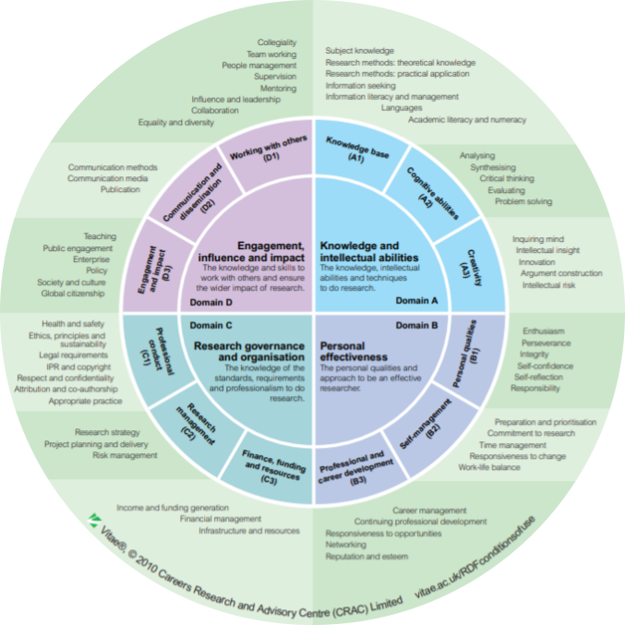
Vitae’s Researcher Development Framework (RDF)
https://www.vitae.ac.uk/vitae-publications/rdf-related/researcher-development-framework-rdf-vitae.pdf/view

Slide 16
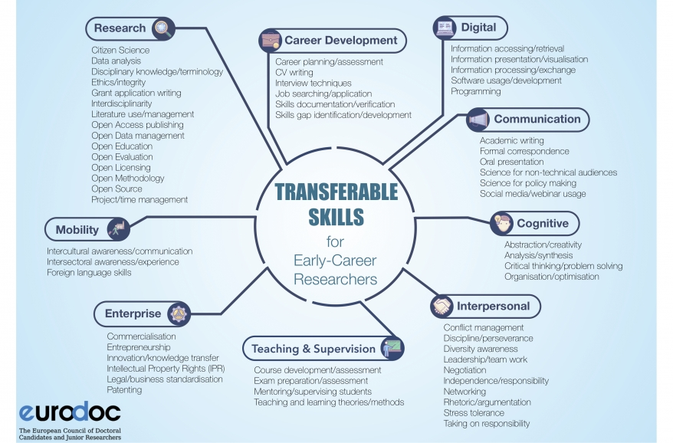
Eurodoc’s transferable skills for early career researchers
http://eurodoc.net/news/2018/press-release-eurodoc-report-on-transferable-skills-and-competences

Slide 17
30/09/2020

Slide 18
02/10/2020

Slide 19
06/10/2020

Slide 20
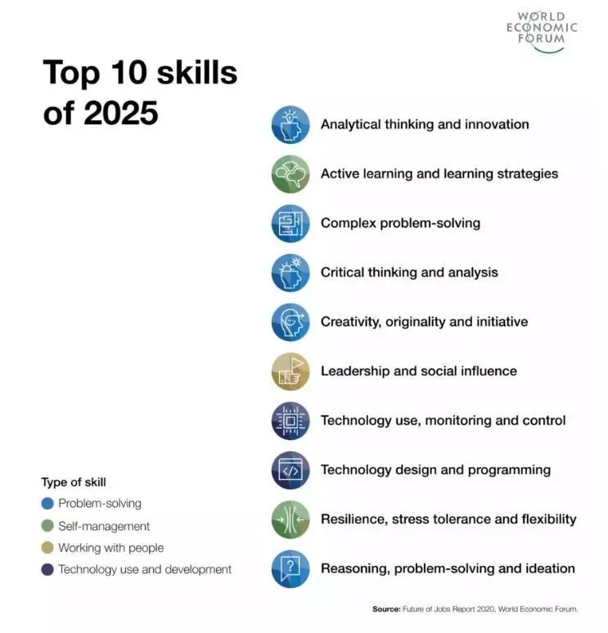
World Economic Forum (WEF) top 10 skills of 2025
https://www.weforum.org/agenda/2020/10/top-10-work-skills-of-tomorrow-how-long-it-takes-to-learn-them/

Slide 21
What makes an application stand out to you?
‘Not simply listing all of your publications or conference papers. If you’ve been invited to give a keynote at a conference, or something – that’s clearly a big achievement. It’s about being judicious with your academic-specific information.’
Programme Director, IBM Research UK

Slide 22
How to unpack me as a ‘researcher’ into skills?
Time
Research output
Real-time skill spotting

Slide 23
Thinking about your research output/s in a different way
Example: [Insert title of one of your research outputs here]
List the technical skills this research required
List the ‘other’ skills you used
collaboration, working to deadlines, communication skills, budget management
List any attributes you developed or showed
problem-solving, fast learner, happy working with a level of ambiguity

Slide 24
How to unpack me as a ‘researcher’ into skills?
Time
Research output
Real-time skill spotting

Slide 25
Skill spotting guide
Skill
S
M
T
W
T
F
S
Notes
Reflection
Action

Slide 26
Skill spotting guide
Skill
S
M
T
W
T
F
S
Notes
Cognitive
Abstraction/creativity
*
Designed new presentation with engaging interactive task tailored to audience
Analysis/Synthesis
*
Analysed feedback data to design new presentation
Critical thinking
Problem solving
*
Identified limit with online platform, found suitable alternative
Organisation/optimisation
*
Suggested alternative agenda and way to run team meetings
Didn’t identify any examples of using ‘critical thinking’ this week.
Surprised how having this list of skills focussed my attention on things that I would have overlooked otherwise.
Reflection
Focus next week on ‘critical thinking’ skill.
I will find an example of critical thinking and see how I can translate it to my work. I will record one example of using critical thinking by the end of next week.
Action

Slide 27
Some questions to ponder
What skills do your postdocs have?
How do you help them realise their skills?
Do you explicitly discuss professional skills aside from technical/research skills with your postdoc?
Any tried and tested approaches to helping your postdoc recognise their skills?

