Slide 1
Expectations and the role of a PI
Dr. Andrew Holmes
Research Staff Developer

Slide 2
What is the role of a PI? Definitions vary
‘the individual designated by the grantee, and approved by NSF, who will be responsible for the scientific or technical direction of the project’ (from the National Science Foundation (NSF) https://www.nsf.gov/pubs/policydocs/pappguide/nsf10_1/)
‘The Principal Investigator takes responsibility for the intellectual leadership of the research project, for the overall management of the research and for the management and development of researchers’ UK Concordat to Support the Career Development of Researchers (Vitae, 2008).
Notes:
Going beyond the rather sparse definition from the NSF, Vitae’s definition crucially includes the management and development of researchers

Slide 3
Role of the PI put another way…
‘As the head of a lab, you are responsible for fundraising, fund managing, purchasing materials and equipment (some of which is extremely specialist, even unique), training and managing staff working with dangerous materials, publicizing the current research, and planning future research...’
Project management
Fundraising
Fund/budget management
Horizon scanning
Requisition management
Training and managing people
From J S Tregoning and J E McDermott (2020) ‘Ten Simple Rules to becoming a principal investigator’ PLOS Computational Biology,16, 2, pp. 4.
Public engagement
Notes:
A perhaps less intimidating definition of the role that a PI is responsible for is

Slide 4
Role of the PI put another way…continued
‘… As a teacher you are expected to inspire and educate the next generation with a range of teaching styles that are appropriate for either 300 students in a lecture or for a single student, as a mentor...’
Project management
Fundraising
Fund/budget management
Horizon scanning
Requisition management
Communication
Teaching
Training and managing people
From J S Tregoning and J E McDermott (2020) ‘Ten Simple Rules to becoming a principal investigator’ PLOS Computational Biology,16, 2, pp. 4.
Public engagement
Notes:
A perhaps less intimidating definition of the role that a PI is responsible for is

Slide 5
Role of the PI put another way…continued
‘… On top of this, you are expected to help with the administration of a large complex organization with upwards of 10,000 staff. Hiring good people can help to distribute some of this load.’
Project management
Fundraising
Fund/budget management
Horizon scanning
Requisition management
Communication
Teaching
Training and managing people
Administrative duties
From J S Tregoning and J E McDermott (2020) ‘Ten Simple Rules to becoming a principal investigator’ PLOS Computational Biology,16, 2, pp. 4.
Public engagement
Hiring/recruitment
Notes:
A perhaps less intimidating definition of the role that a PI is responsible for is

Slide 6
Expectations - Researcher Development Concordat
“Agreement between stakeholders to improve the employment and support for researchers and researcher careers in higher education in the UK”
Stakeholders: Funders, Institutions, Researchers and Managers of Researchers.
Three principles:
Environment and Culture
Employment
Professional and Career Development
UK Concordat to Support the Career Development of Researchers (2019)
https://researcherdevelopmentconcordat.ac.uk/

Slide 7
Researcher Development Concordat – Institutions
Provide opportunities, structured support, encouragement and time for researchers to engage in a minimum of 10 days professional development pro rata per year, recognising that researchers will pursue careers across a wide range of employment sectors.
Provide training, structured support, and time for managers to engage in meaningful career development reviews with their researchers.
UK Concordat to Support the Career Development of Researchers (2019)
https://researcherdevelopmentconcordat.ac.uk/

Slide 8
Researcher Development Concordat – PIs
Engage in regular career development discussions with their researchers, including holding a career development review at least annually.
Support researchers in exploring and preparing for a diversity of careers, for example, through the use of mentors and careers professionals, training, and secondments.
Allocate a minimum of 10 days pro rata, per year, for their researchers to engage with professional development, supporting researchers to balance the delivery of their research and their own professional development.
UK Concordat to Support the Career Development of Researchers (2019)
https://researcherdevelopmentconcordat.ac.uk/

Slide 9
Researcher Development Concordat – Postdocs
Take ownership of their career, identifying opportunities to work towards career goals, including engaging in a minimum of 10 days professional development pro rata per year.
Explore and prepare for a range of employment options across different sectors, such as by making use of mentors, careers professionals, training and secondments.
Maintain an up-to-date professional career development plan and build a portfolio of evidence demonstrating their experience, that can be used to support job applications.
Positively engage in career development reviews with their managers.
UK Concordat to Support the Career Development of Researchers (2019)
https://researcherdevelopmentconcordat.ac.uk/

Slide 10
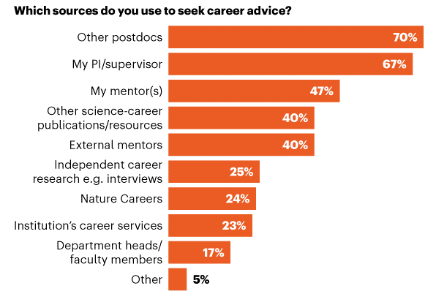
Where do postdocs look for career advice?
Woolston, C. (2020) ‘Uncertain prospects for postdoctoral researchers’, Nature, 588, 181-184. https://doi.org/10.1038/d41586-020-03381-3

Slide 11
Perspectives from postdocs
“Share their experience of how they became a PI.”
“Keep track of former postdocs, what they've gone on to do to use as examples for alternative careers.”
“Belief in my skills and how these can translate to success outside of academia.”
“Separate to work catch ups and PDRs, regular meetings (every 3 months?) focusing on PDRA's career, aspirations, mental health etc.”
“Not making career conversations weirdly formal compared to other interactions.”
Quotes from anonymous postdocs.

Slide 12
Expectations for PIs
PIs are NOT expected to be career coaches
“PIs don’t have to know everything, they could know what they don’t know and know where to point you.”
Anonymous postdoc
Not expected to do or know everything.
Notes:
Run a poll in zoom asking the question ‘How long is your CV?’ with the options 1 page, 2 pages, 3 pages, 4 pages, 5 pages, 6+ pages
Discuss the answers to the poll

Slide 13
Thank you for your time!
For more information, visit: liv.ac.uk/prosperproject
Get in touch: prosper.postdoc@liverpool.ac.uk
Follow us on Twitter: @ProsperPostdoc
Visit the Prosper Portal: https://prosper.liverpool.ac.uk
Except where otherwise noted, this work is licensed under the Creative Commons Attribution-NonCommercial-ShareAlike 4.0 International License. To view a copy of this license, https://creativecommons.org/licenses/by-nc-sa/4.0/

