Slide 2
Supporting your postdocs with their career development: LinkedIn
Dr. Eamon Dubaissi
Research Staff Developer

Slide 3
Section outcomes
Understand why postdocs should engage with LinkedIn for their career development
Have a basic overview of a LinkedIn profile
Suggestions on how you, as a PI, could support your postdocs with LinkedIn
Outlining some potential benefits to you and your research group of your postdocs engaging with LinkedIn

Slide 4
Why should you encourage your postdocs to engage with LinkedIn?

Slide 5
It’s vast
LinkedIn is a professional networking and career development platform with approximately 700 million users worldwide

Slide 6
It enables expansion and diversification of networks
One of the biggest stressors for postdocs is being uncertain of other careers and where they might fit should their contract not be extended or they wish to move beyond academia
A postdoc’s network is often limited to people within academia, so it can be difficult to explore wider options
LinkedIn provides a means by which to expand and diversify their networks, research organizations of interest to them and identify/apply for jobs

Slide 7
But why network at all?
In academia, networking is critical to career trajectory, (Heffernan, 2021)……but the same also applies elsewhere
Most jobs are found through networks (Ioannides and Loury, 2004) and these jobs are better suited to the applicant based on their education and usually offer better career prospects (Franzen and Hangartner, 2006)
But postdocs can be uncomfortable with networking, even though they recognize its value (Chakraverty, 2020)
Heffernan T. 2021. Higher Education Research and Development 5: 981-94.
Ioannides, Y. M., and L. D. Loury. 2004. Journal of Economic Literature 42: 1056–93.
Franzen, A., and D. Hangartner. 2006. European Sociological Review 22: 353–68.
Chakraverty D, 2020 International Journal of Doctoral Studies 15: 329-52.

Slide 8
The many functions of LinkedIn
Connect and message other professionals in your network
Join professional groups for targeted networking opportunities
Give and receive recommendations
Receive notifications from your contacts
Research organisations and people within those organisations
Find and apply for jobs
Create your own company page and recruit to your own organisation
Complete courses through LinkedIn Learning
Share ideas and professional content (e.g. blogs/videos) – thought leadership

Slide 9
The basics of a LinkedIn profile

Slide 10
Basic premise of a LinkedIn profile
It should position someone for their next career move.
When it becomes clear what this next career move might look like, their LinkedIn profile should reflect this.
Postdocs can expand and leverage their network, conducting informational interviews to broaden their knowledge of different career paths, which then can inform further development of their profile.

Slide 11
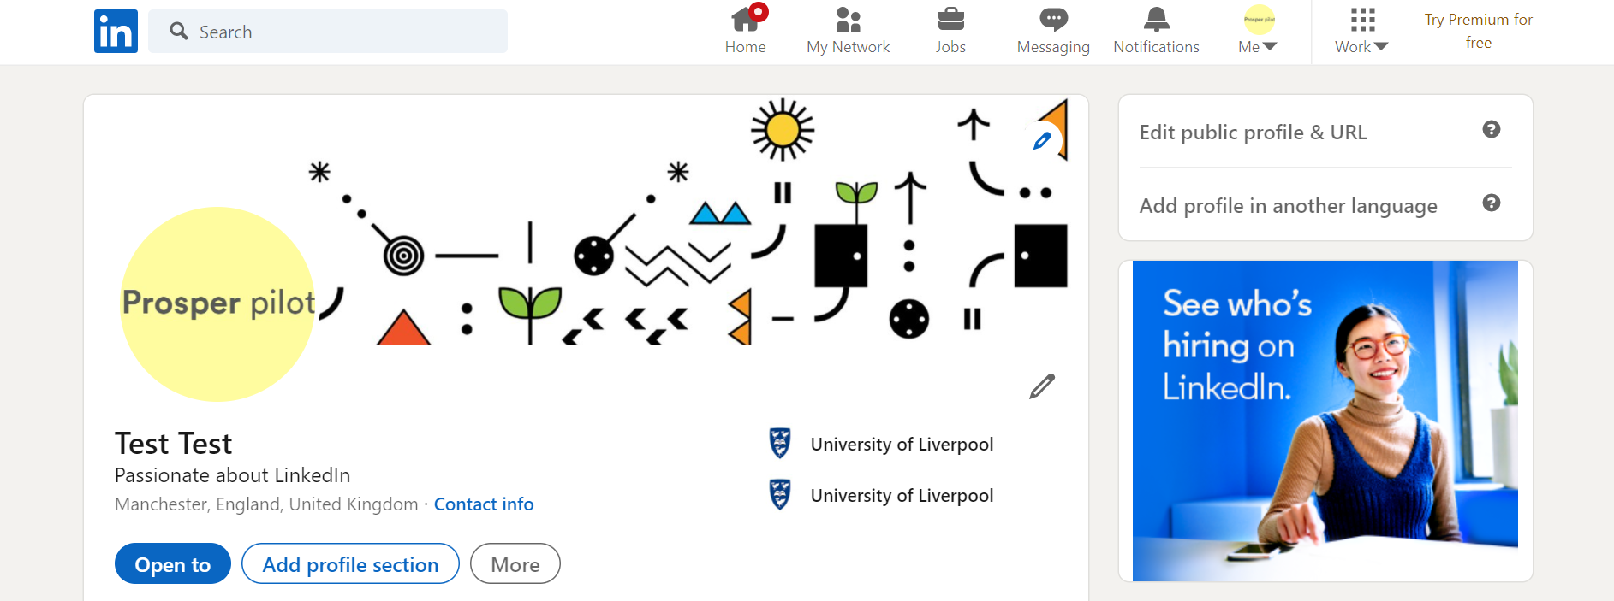
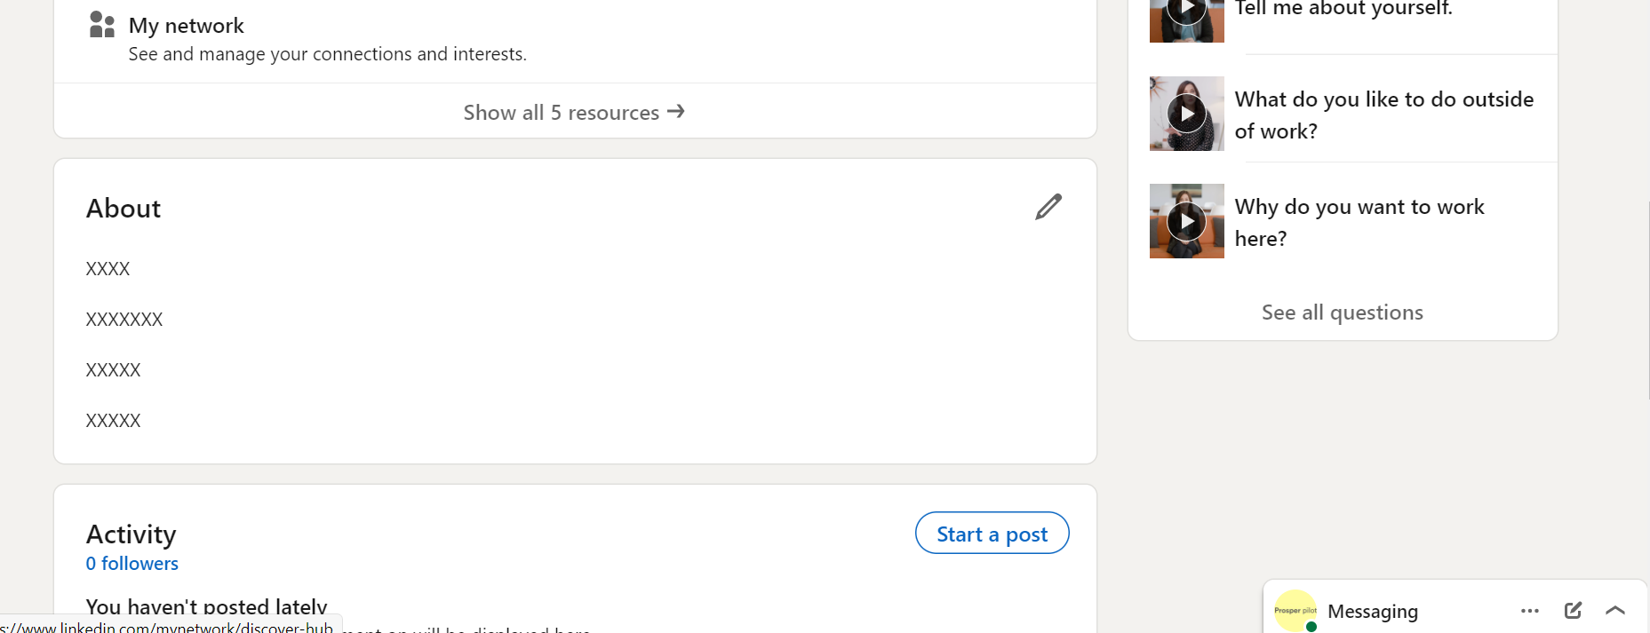
Background photo
Experience
Education
Skills
Recommended and Additional sections
Your photo
Your Name
Professional Headline
About you summary

Slide 12
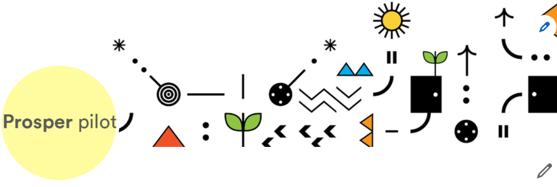
Profile photos
Does not need to be taken by a professional photographer, but it should be professional.
Dress appropriate to the industry they are targeting.
Remember to smile.
Can be accompanied by an additional background photo (e.g. a speaking engagement; first slide of talk).

Slide 13
Professional Headline
Accompanies the name and photo in searches. It can be used to show up parts of someone’s personality (who they are and what they care about)

Slide 14
‘About’ section
Opportunity to tell their story; showing their self-efficacy and belief in their own ability
Best possible future self
Technical skills, transferable skills and personal characteristics/attributes
Step into the shoes of a hiring manager – what qualities/skills/experiences would they be looking for in a potential employee
http://www.sabrina-woods.com/linkedin.html

Slide 15
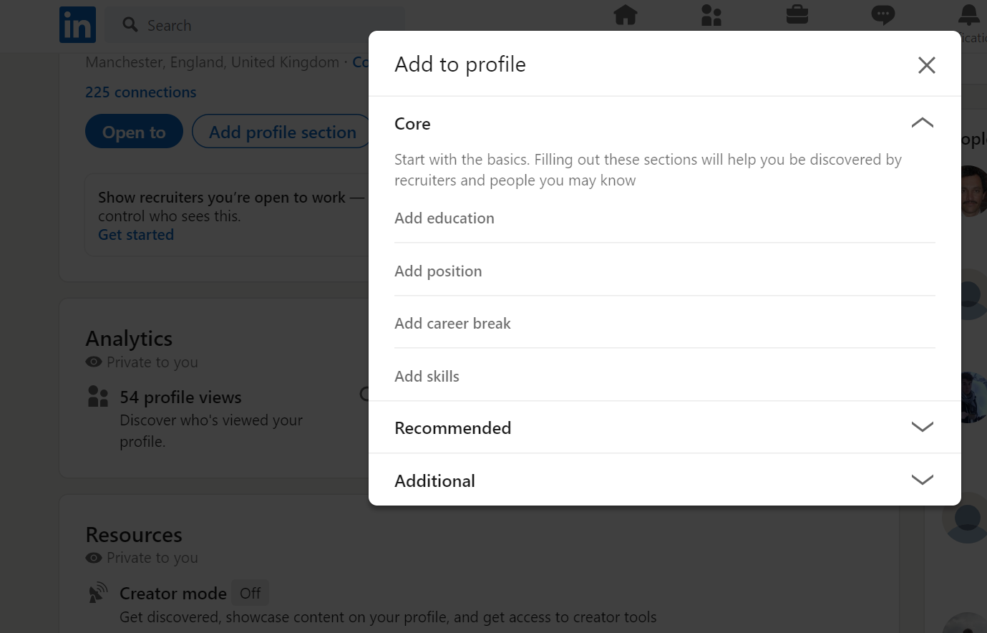
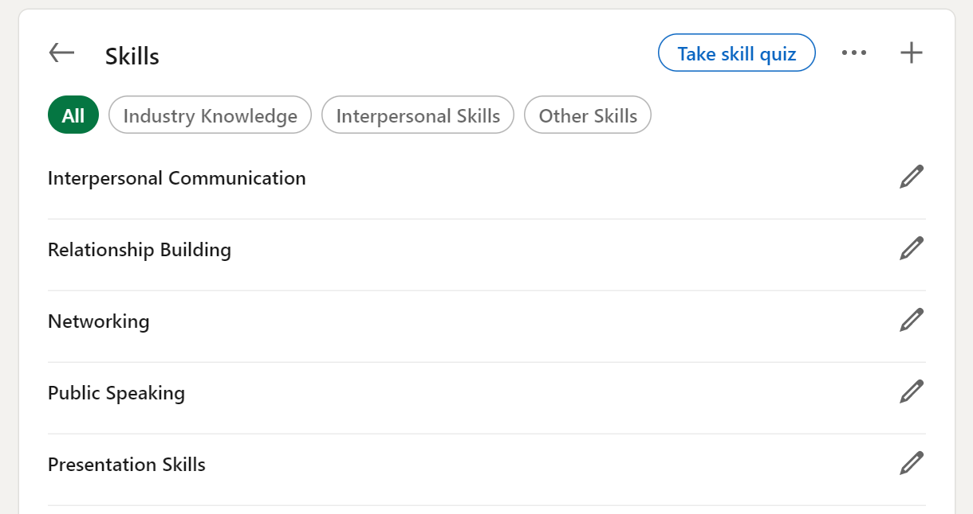
Enhancing your profile: core sections
Skills
Reorder

Slide 16
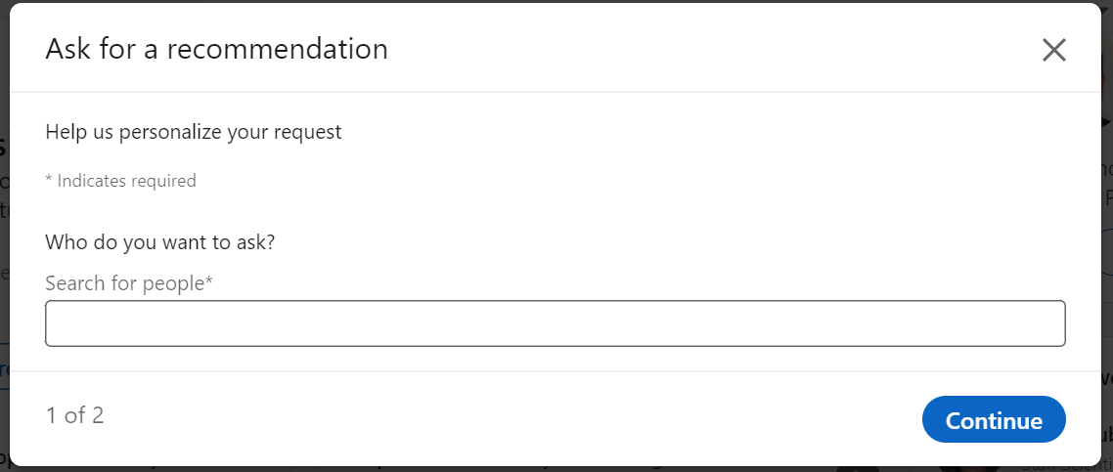
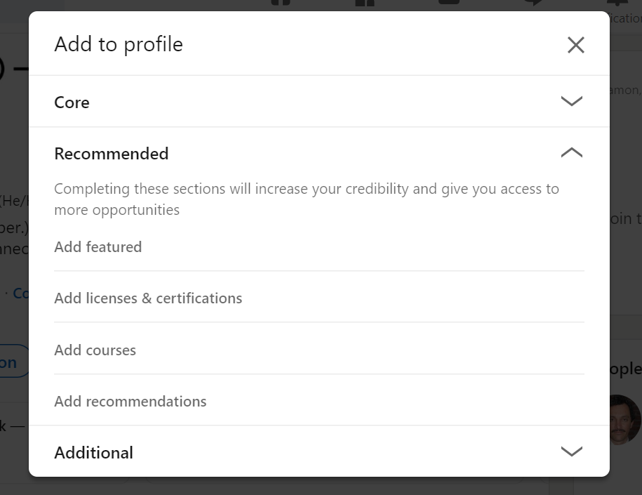
Enhancing your profile: recommended sections
Recommendations

Slide 17
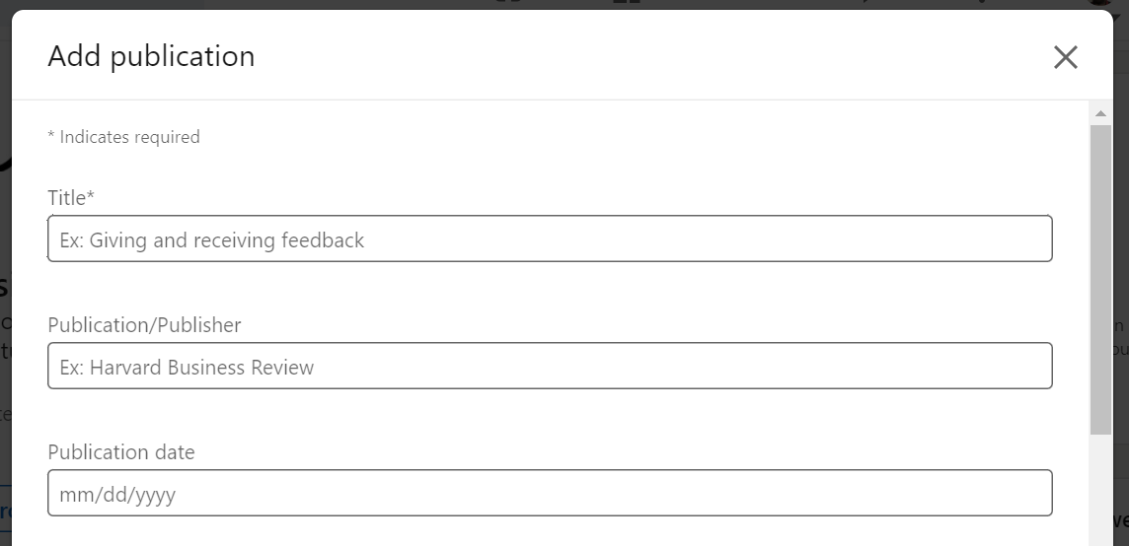
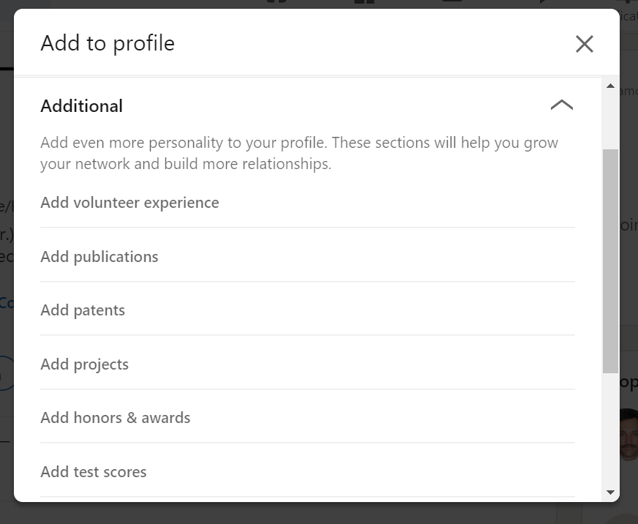
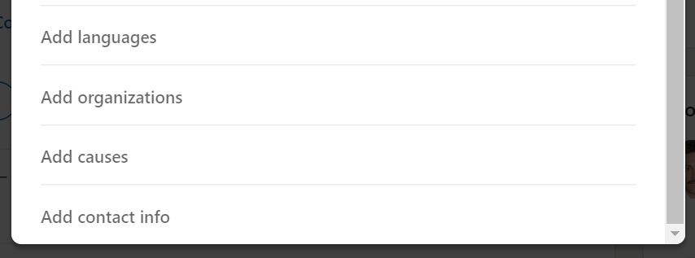
Enhancing your profile: additional sections
Publications
Causes
Interests (through what you follow)

Slide 18
How can you support your postdoc with LinkedIn?

Slide 19
Small things – they don’t expect you to be an expert in LinkedIn
Talk about LinkedIn in career conversations: Are you using LinkedIn? Have you updated your LinkedIn profile recently? Have you thought about using LinkedIn to expand your network and for career exploration?
Offer to read their profiles. Are they articulating the skills that you know they have? Feedback can give them new insight into themselves
If on LinkedIn yourself, give your postdocs a LinkedIn recommendation. Shows your support and gives a confidence boost
If you’re on LinkedIn yourself, share/suggest connections: e.g. former postdocs and PhD students of yours – what are they doing now? Could be a way for them to start exploring different pathways
Follow-up: How’s it going with LinkedIn? What have you found? Who have you connected with? Any informational interviews?

Slide 20
Potential benefits of postdocs engaging with LinkedIn for you and your research

Slide 21
A more confident, less stressed, supported and more in control postdoc is better for productivity
Enhance your reputation for supporting your postdocs with their career development
Outward-looking postdoc: potential for external collaborations
Postdocs as ambassadors for your research group now and in the future
Opportunity for more people to see the research that is done in your group
Join LinkedIn yourself to keep in contact with former postdocs
Grow your own network through their network

Slide 22
Thank you for your time!
For more information, visit: liv.ac.uk/prosperproject
Get in touch: prosper.postdoc@liverpool.ac.uk
Follow us on Twitter: @ProsperPostdoc
Visit the Prosper Portal: https://prosper.liverpool.ac.uk
Except where otherwise noted, this work is licensed under the Creative Commons Attribution-NonCommercial-ShareAlike 4.0 International License. To view a copy of this license, https://creativecommons.org/licenses/by-nc-sa/4.0/

