Slide 2
A Coaching Approach to Career Conversations.
Denise Chilton
Career and Leadership Coach
Denise Chilton Coaching

Slide 3
What we will cover…
Why a coaching approach to career conversation?
The coaching relationship
Coaching principles
Contracting
Core Skills
Time for your questions

Slide 4
What we will cover next time…
Structuring a coaching conversation
Offer a coaching model - GROW Coaching in action… live demonstration
Opportunity to have a go

Slide 5
Begin with the end in mind
What do you want to be saying as you leave the session today?
I am…. I have …….
Present tense
Positive
Personal
Possible

Slide 6
When it comes to having a career conversation what is the real challenge for you?

Slide 7
Coaching Conversations..
Where are you now?
Where are you heading?
What support do you need?
Where can I (as the PI) be most useful?

Slide 8
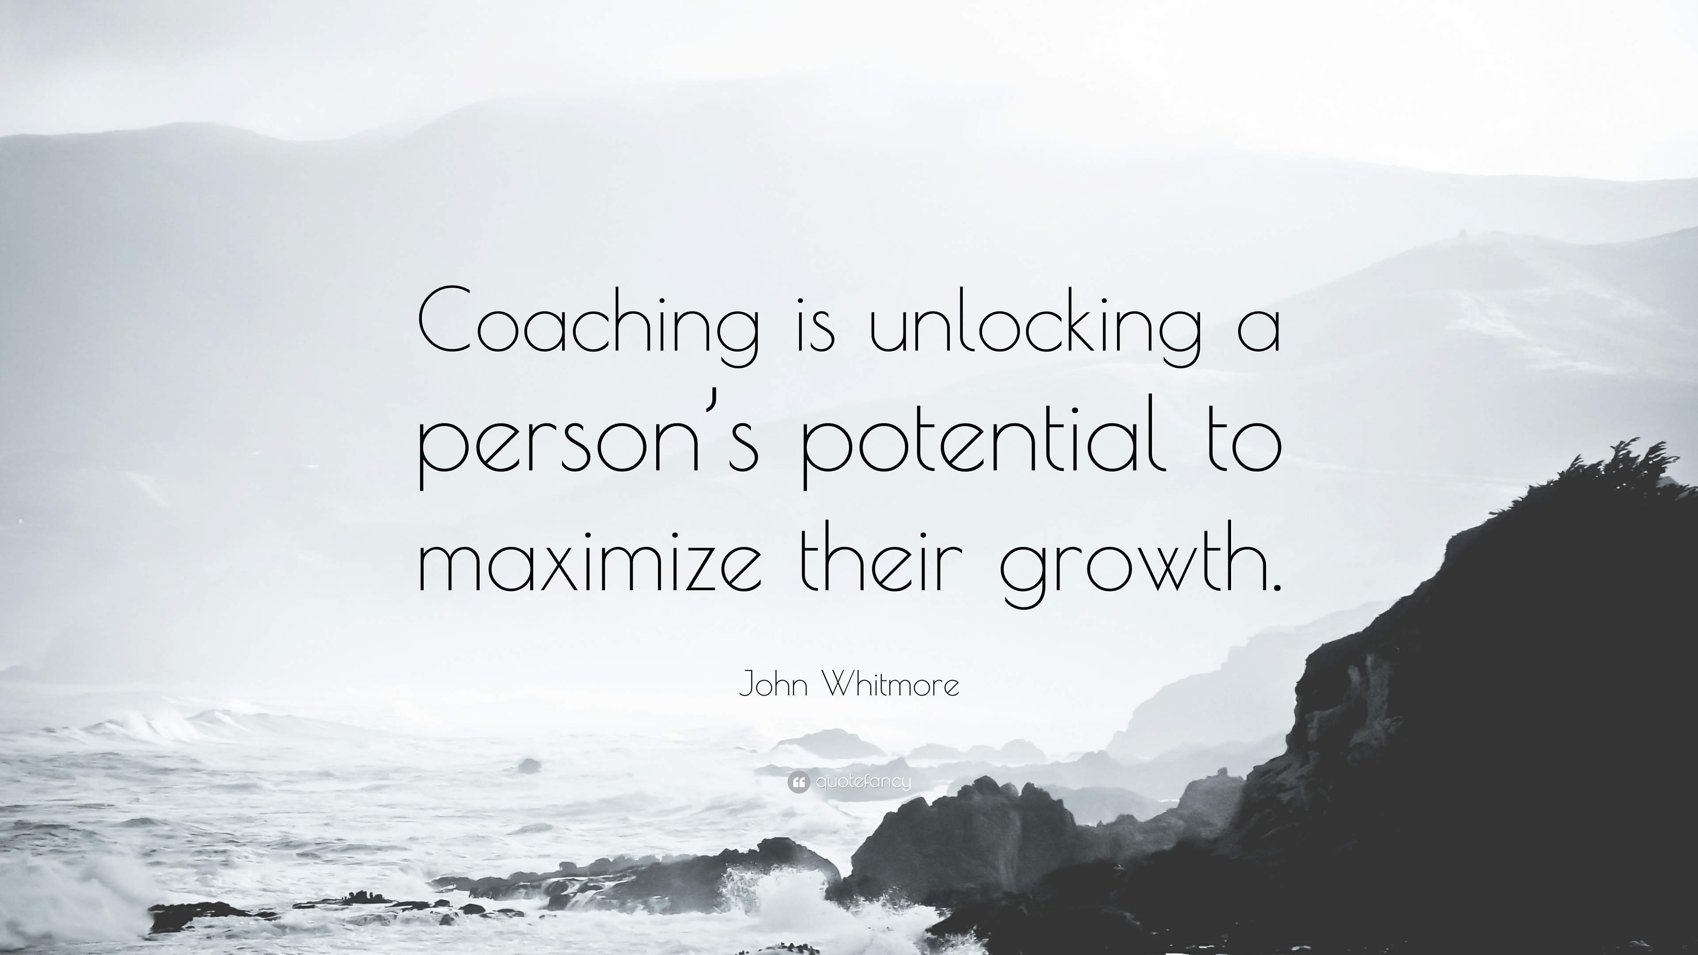
Why a coaching approach?

Slide 9
Coaching Conversations
The Coaching Relationship

Slide 10
Different Hat!

Slide 11
Coaching Relationship…
Postdoc is resourceful and expert in their life
Agenda for the time together comes from the postdoc
PI holds a safe, non-judgemental space to ask questions and help unlock thinking
A thinking partnership find creative solutions together

Slide 12
Coaching Conversations
Contracting – How are we going to work together?

Slide 13
Contracting… How will we work together?
Set the expectations
Goals for the conversation – Begin with the end in mind
How often will we meet? For how long?
Contact in-between sessions
How will we keep confidentiality
Honour the time commitment
Boundaries
Accountability

Slide 14
Coaching Conversations
Core Skills

Slide 15
Core Skills…
Asking more questions – What and How
Staying curious a little longer
Silence
Listening
Identifying barriers
Reflecting Back

Slide 16
The Power of Open Questions
Who?
What?
Where?
When?
How?
Why?
Notes:
Welcome back
How did you get on with the list – perhaps you would like to review the Paul conversation again and see how many of the open questions you picked up.
Open questions encourage people to do great thinking
They can’t answer Yes or No
Really powerful questions create new thinking that can lead to new possibilities, growth and change.
Homework
We encourage you to start to notice the questions that you are using
Maybe think of one or two different open questions that feel comfortable to you that you can start to use more often in your conversations.
A good place to start is at the beginning
What brings you here today?
What would you most like to get out of our time together?
What would you like to have at the end of our conversation?
What’s getting in the way?
What are you assuming that’s stopping you?
Note about beware of WHY?
And using If…to overcome barriers – more of this in webinar 4….

Slide 17
Coaching Conversations
A word on advice

Slide 18
What will you do?
ction
hanges
hings
C
A
T
One thing I am taking away today...
C
T

Slide 19
Any Questions

Slide 20
Thank you. Get in touch:
Denise Chilton
hello@denisechilton.co.uk
www.denisechilton.co.uk
Twitter @DeniseChilton
Except where otherwise noted, this work is licensed under the Creative Commons Attribution-NonCommercial-ShareAlike 4.0 International License. To view a copy of this license, https://creativecommons.org/licenses/by-nc-sa/4.0/

