Slide 1
Breathing and relaxation
Hilary Clarke (Chartered MCIPD)
Organisational Development, University of Liverpool
Led by
Supported by
An Academy project
Except where otherwise noted, this work is licensed under the Creative Commons Attribution-NonCommercial-ShareAlike 4.0 International License. To view a copy of this license, https://creativecommons.org/licenses/by-nc-sa/4.0/

Slide 2
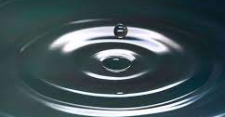
Breathing and Relaxation
Hilary Clarke

Slide 3
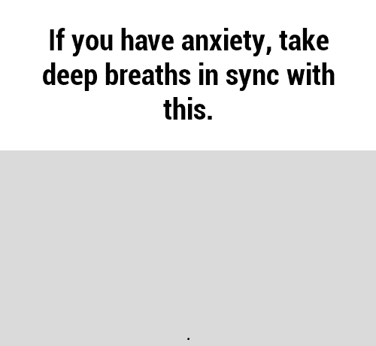
Breathing Exercise

Slide 4
Peaceful relaxation

