Slide 2
Discovering and Developing Personal Strengths
Coaching ourselves: career catalyst tool kit

Slide 3
Session Guidelines
1. Introduce yourselves to each other.
2. Decide who will be the timekeeper. The timings for each slide are top right.
3. Read the pages aloud and follow the instructions.

Slide 4
Postdoc Check-In
5 min
Take turns at reading the instructions aloud. Follow all the instructions.
Each person share and reflect on a story that has happened to you this week, this could be around your work or personal life, a memorable conversation, a meeting, or an event.
Or
Follow up on anything you have reflected or taken action on since your last session.

Slide 5
Session Agenda
3 min
Postdoc check-in
Topic overview
Introduction
Positive psychology approach to strengths
VIA character strengths survey
Strength-based interview questions
Spotting strengths in others
Other definitions of strengths
Final reflection
Facilitators notes

Slide 6
Topic overview: Discovering and Developing Personal Strengths
2 min
You will explore strengths as defined within the field of positive psychology. Identify your own character strengths both recognised and latent, how you use those strengths or not, and whether these can become part of your decision-making criteria about careers.
In this session you will:
Learn about character strengths and identify your character strengths
Discuss how you can use your character strengths to explore related careers
Discover how you can spot character strengths in others
Notes:
Always have 3 learning points…

Slide 7
Positive psychology approach to character strengths
5 min
What is right?
What is working?
What is strong?
Strengths are ways of being (thoughts, feelings and behaviours) that make us feel:
It is also interesting to consider the meaning of weakness when looking through the positive psychology lens, it isn't something that you are bad at (necessarily), but something that weakens you: drains your energy and interest.
strong
energised
engaged
Photo by Anna Shvets: https://www.pexels.com/photo/man-with-a-gay-pride-flag-4611740/
Notes:
Always have 3 learning points…

Slide 8
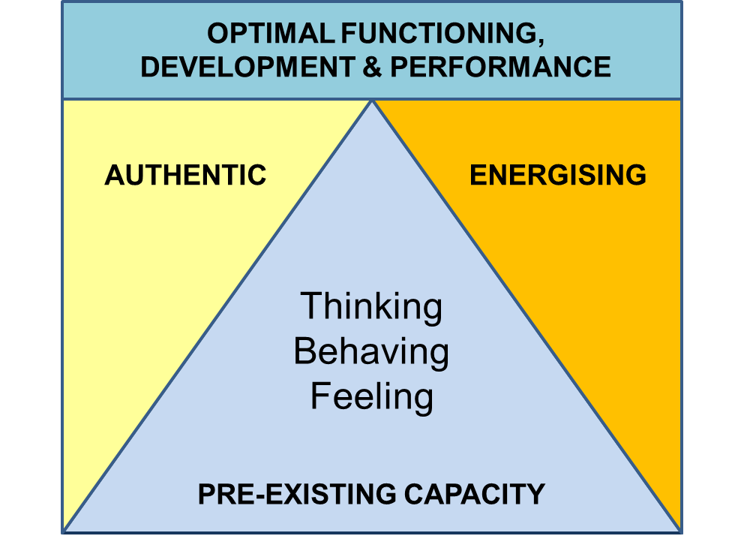
Researcher Alex Linley’s definition of strength:
5 min
Strengths enable authenticity: when you are using a strength it feels like the real you. This has a core influence on wellbeing and life satisfaction.
Strengths enable optimal functioning, development and performance: when you use a strength you feel more engaged, alive, vigorous, in flow. This enables optimal development because we learn much more easily in the areas we are already strong.
Notes:
Always have 3 learning points…

Slide 9
VIA character strengths survey
5 min
The Values in Action (VIA) Character Strengths Survey
was designed by positive psychologists Christopher Peterson and Martin Seligman (2004).
Peterson and Seligman suggested that there are a number of universal positive characteristics that all humans will exhibit to some degree because of evolution. Further information about their extensive research.
In other words everyone has varying degrees of these positive traits.
If you want to undertake a quantitative assessment of your VIA Character Strengths there is a 10-minute strengths inventory test available for free, but you do have to register an account at the website.
You may choose to take the quantitative assessment in your own time, but Peterson and Seligman also advise people to do a qualitive self-assessment, which is what you will do in this session.
Notes:
Always have 3 learning points…

Slide 10
Qualitative self-assessment: VIA character strengths
10 min
Download: VIA strengths and descriptions
As you read through the strength descriptions, consider these questions:
Do I feel naturally drawn to this strength?
Is it the real me?
Do I feel excited or energised by it?
Do I feel surprised by it?
How much do I use this strength currently – at work, at home, in my hobbies, in my community?
Would others see it in me?
Get to a list of five that feel most like 'you'.
Notes:
Always have 3 learning points…

Slide 11
Strength pair and share
15 min
Pair up and take turns at answering one of the questions presented here. Next pair up with someone else and repeat until all the questions have been answered. 3 minutes for each round.
Which of your strengths would you like to use more?
How could you do that?
Choose one of your partners strengths, that intrigues you, and ask them how they express it?
How do you express your character strengths in your work, life and hobbies?
Which of the character strengths do you admire in other people?
Notes:
Always have 3 learning points…

Slide 12
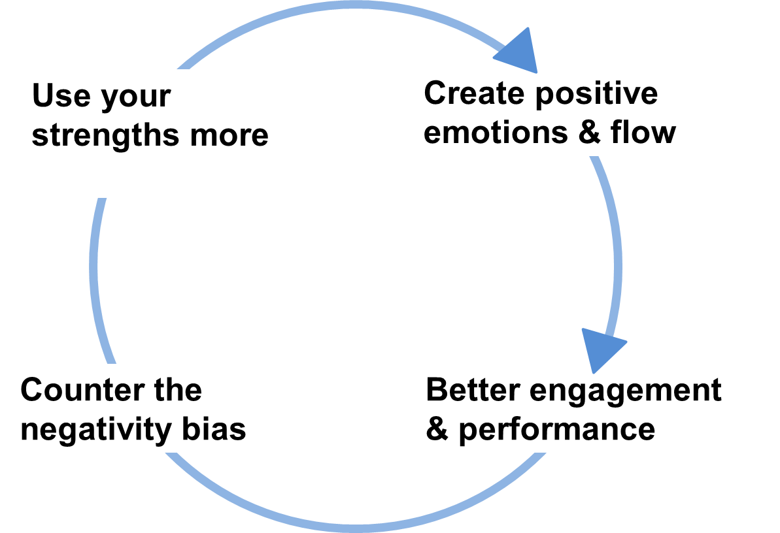
Character strengths: a virtuous circle
5 min
Take a moment to reflect on how you feel after talking about your strengths.
Using your character strengths more can create a virtuous circle because:
Strength use increases positive emotion and flow (being in the zone)
This improves engagement and performance
Which counteracts the negativity bias (human tendency to focus on problems)
Notes:
Always have 3 learning points…

Slide 13
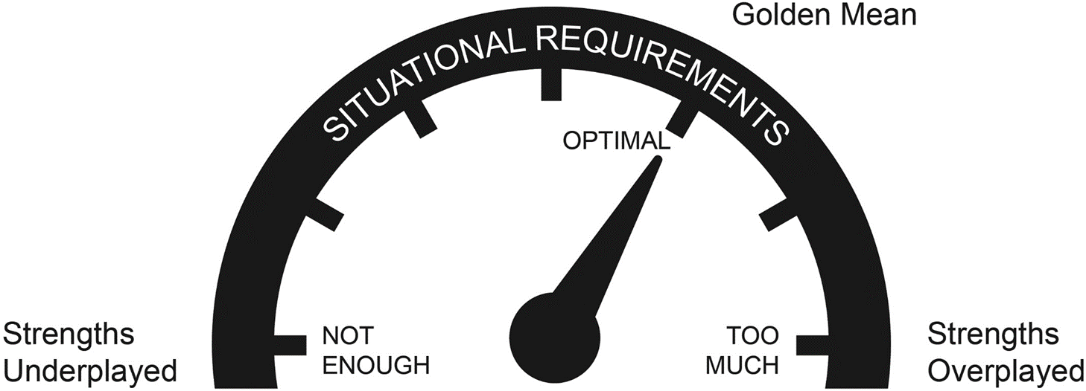
Strengths and performance
Another idea from positive psychology is that strengths can be under or overplayed.
Discuss
What do you think of this approach to strengths?
Do you see any of your strengths as under or overplayed?
How could use another of your strengths to overcome this?
Notes:
Always have 3 learning points…

Slide 14
Strength-based interview questions
10 min
What do you like to do in your spare time?
What energises you?
How would your close friends describe you?
Do you most like starting tasks or finishing them?
Do you prefer the big picture or the small details?
Describe a successful day. What made it successful?
What are you good at?
What are your weaknesses?
When did you achieve something you're really proud of?
What do you enjoy doing the least?
Do you find there are enough hours in the day to complete your to-do list?
What tasks are always left on your to-do list?
How do you stay motivated?
How do you feel about deadlines?
Have you ever done something differently the second time around?
Do you think this role will play to your strengths?
Discuss:
What are your strategies for answering these questions in interviews?
How can knowledge of your character strengths help you here?
Share examples...
Notes:
Always have 3 learning points…

Slide 15
Strength-based interview practice
5 min
This routine is a good way of preparing for strength-based interview questions.
Choose one of your skills, strengths or capabilities, and have a go at answering the questions below.
You can draw on any example. This could include an example from your research work, other work, or volunteering, sports or hobbies. Think about examples you might use with an employer.
What was the situation where you demonstrated this strength? (suggest 30-50 words)
What did you do? What action did you take? How did you use your strength? (suggest 60-80 words)
What were the results of your actions? How did you feel when using your strengths? What was the impact on you or others? Could you have used your strengths to improve the outcome? What did you learn about yourself and your strengths? (suggest 120-150 words)
Notes:
Always have 3 learning points…

Slide 16
Strength spotting activity
20 min
For this activity each of you will share one story with the group - it can be a time when something that you did caused a positive outcome (it does not need to be life-changingly significant!) like a success with people, in relationships, an interest, music, a hobby, a project task or work event, or volunteer related.
Spend 5 minutes individually preparing your examples
When you are ready take turns at being the storyteller
As the storyteller gives you their example, the rest of the group will be strength spotters
As a strength spotter your role is to notice and note down any strengths that you hear in the story
At the end of the story the strength spotters feedback the strengths they have noticed to the storyteller and explain their rationale.
Download: Strength Vocabulary to help strength spotters identify positive characteristics
Notes:
Always have 3 learning points…

Slide 17
Other definitions of strengths
10 min
There are several theoretical approaches to strengths, each offering a different perspective on how strengths can be defined, identified, and developed. Here are a few examples:
Appreciative inquiry: This approach, developed by David Cooperrider and others, emphasises the power of positive inquiry and dialogue to create positive change. Appreciative inquiry focuses on identifying and amplifying an individual's or organization's strengths, rather than identifying and fixing problems or deficits.
Strengths-based leadership: This approach, developed by Tom Rath and Barry Conchie, emphasises the importance of leveraging an individual's strengths in leadership and management. Strengths-based leadership suggests that by focusing on strengths rather than weaknesses, leaders can maximise employee engagement, productivity, and satisfaction.
Talent development: This approach emphasises the idea that individuals have innate talents and strengths, which can be developed and refined over time with deliberate practice and effort. Talent development involves identifying an individual's strengths and providing them with opportunities to cultivate and apply those strengths in a meaningful way.
Notes:
Always have 3 learning points…

Slide 18
Final reflection
5 min
What do you take away from this session?
Share your thoughts with the group
Notes:
Photo by Hudson Hintze on Unsplash

Slide 19
Facilitators notes
The VIA strengths framework emphasises the positive aspects of human nature and character, providing a comprehensive and universal understanding of what is best in individuals. According to the theory created by Christopher Peterson and Martin Seligman in the early 2000s, identifying and leveraging their top character strengths, individuals can enhance their well-being, relationships, and achievements.
Debrief questions:
Which character strengths resonated with you the most? Why?
Were there any character strengths that surprised you in your top strengths report? Why or why not?
Can you identify any character strengths that you would like to develop further? How can you work on developing these strengths?
How can you apply your character strengths to your personal and professional life?
Can you think of a time when you used one or more of your character strengths to overcome a challenge or achieve a goal?
How can you leverage your character strengths to build better relationships with others?
What strategies can you use to overcome any challenges or obstacles that may arise as you work to develop your character strengths?
Notes:
Always have 3 learning points…

Slide 20
Thank you.
Get in touch:
Email: prosper.postdoc@liverpool.ac.uk
Website: https://prosper.liverpool.ac.uk/ and
https://www.liverpool.ac.uk/researcher/prosper/
Twitter: @ProsperPostdoc
Except where otherwise noted, this work is licensed under the Creative Commons Attribution-NonCommercial-ShareAlike 4.0 International License. To view a copy of this license, https://creativecommons.org/licenses/by-nc-sa/4.0/

