Slide 2
Overcoming barriers to using LinkedIn
What’s stopping you from engaging?
Dr. Eamon Dubaissi
Research Staff Developer

Slide 3
Session outcomes
Why is it useful to have a LinkedIn profile?
Psychological barriers to using LinkedIn
Security and privacy concerns around using LinkedIn
LinkedIn Premium and the ‘Open to Work’ function

Slide 4
Poll
Q1. Do you feel comfortable to use LinkedIn as a platform to assist in your career development?
Yes
No
Not sure
Q2. What, if anything, do you think prevents you from fully engaging with it?
I don’t understand how to use it
I have security concerns about my data
I don’t like using any social media
I have privacy concerns about who can see what
I’m worried about doing it ‘wrong’
Other

Slide 5
Open discussion
Could you expand on your response to the poll?
What else would be useful to know?

Slide 6
How do you feel about using LinkedIn?
Often presented in a positive way, but not everyone sees it like that
Can view it in a more functional way – neither positive nor negative
Q. What is the minimum required of me to achieve my goals? You can then work from there
Can keep your engagement quite light - peaks and troughs - but keep your profile fairly well updated, for example, when you change positions

Slide 7
Do I even ‘need’ a LinkedIn profile?
Do I need a LinkedIn profile to get a job beyond academia or start my own venture? ……No, not necessarily.
Will it help?……Yes, probably.

Slide 8
Advantages of having a LinkedIn profile
You can be found before jobs are advertised
You can use the jobs board
Research organisations and people
Make connections for careers or develop your business
Can be your professional website

Slide 9
But also…..
Many employers will look you up on LinkedIn before making a hire

Slide 10
Common concerns
Psychological barriers
Security
Privacy

Slide 11
Psychological barriers
Don’t use social media: uncomfortable with being ‘public’
Perfectionist tendencies: I don’t want to do it ‘wrong’
Unfamiliarity: don’t know how to use it

Slide 12
Psychological barriers
Perfectionist tendencies and unfamiliarity with the platform can lead to inaction
This applies to both creating a profile and using the site, in general
Language such as building ‘all-star’ profiles, reaching out to others and ‘building your brand’ can be off-putting for some
If you don’t use any social media, this may feel like a big step

Slide 13
Tips to help overcome psychological barriers
Not black and white - many shades of grey
Find level of comfort, whilst challenging yourself
Start with basic profile and build from there
Small steps rather than all out action
Profile and engagement can evolve with time
‘Listen and lurk’ – how do others use it?
Set yourself incremental goals

Slide 14
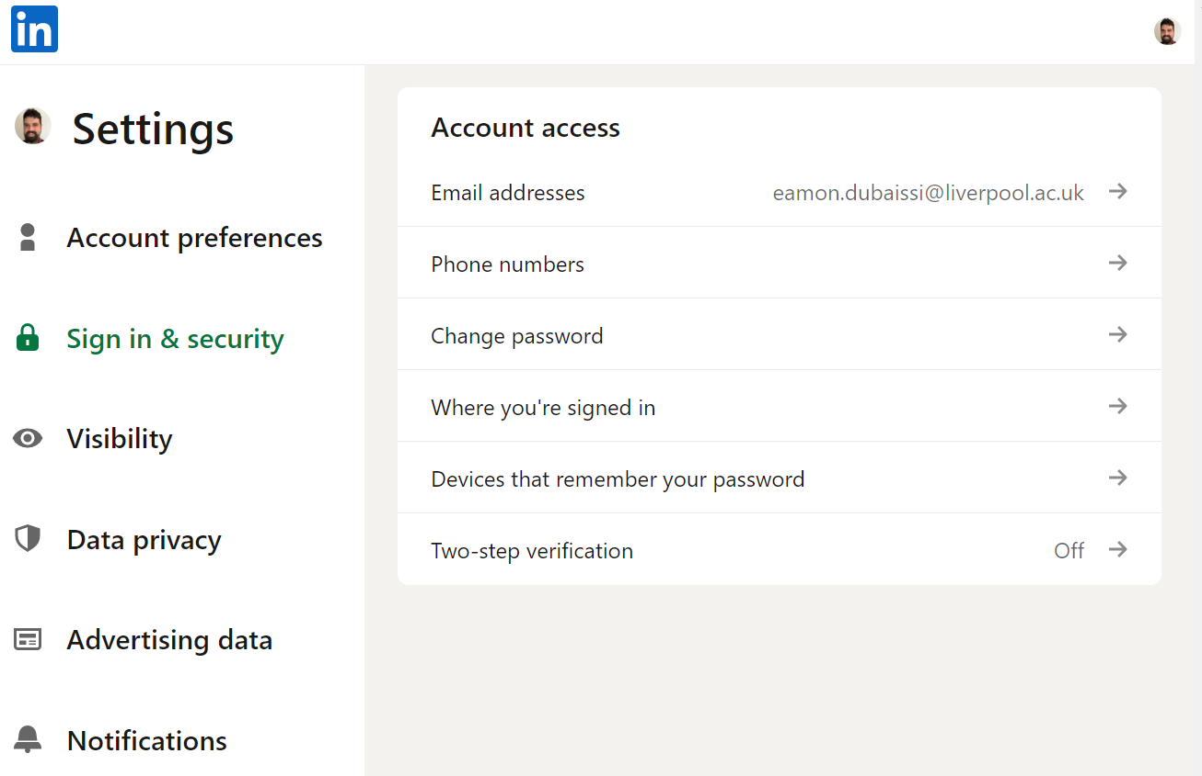
Security concerns
Under your profile photo there is a drop down menu, choose ‘Settings and Privacy’
Some of you may be worried about the security of your data
You have the option of ‘Two step verification’ login or alternatively, ensure you regularly change your password

Slide 15
Security concerns
Syncing contacts and calendars: off by default, but could be useful
Email addresses: inputting more of your email addresses makes you easier to find

Slide 16
Privacy concerns
Some of you may be concerned about having a publicly available profile
There are many privacy settings that you could use if this lowers the barriers to you getting started with LinkedIn
But you need to remember what the point of LinkedIn is in the first place
Consider loosening privacy settings as you get more comfortable. You can still toggle them on and off depending on circumstances

Slide 17
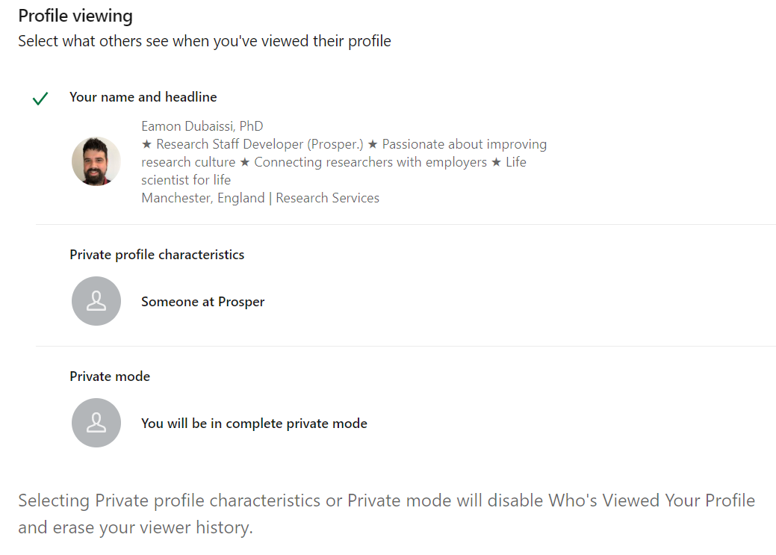
Privacy concerns: changing your visibility
Activating private mode in LinkedIn
They can’t see that you have browsed their profile, but you also can’t see who has viewed your profile

Slide 18
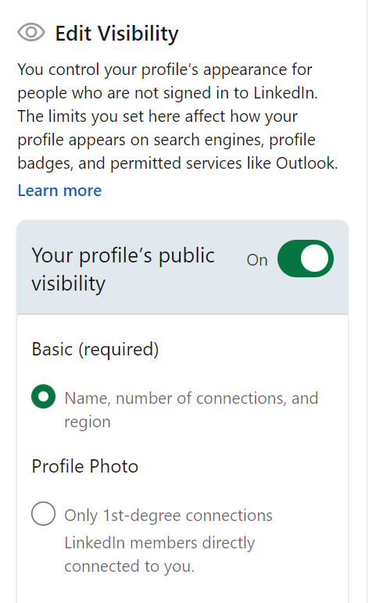
Privacy concerns: Edit your public profile
Control who sees your profile and what they can see when they are not signed in. Can toggle these on and off

Slide 19
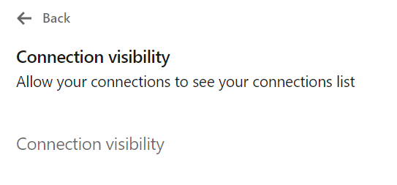
Privacy concerns: Connections
Can toggle on and off to allow your connections to see your list of connections. Generally not an issue, but may not wish to share client list with competitors, for instance

Slide 20
Privacy concerns: Share profile updates
Can switch this off so that your connections don’t see every small change that you make. But it may be useful to have this on if you get promoted or change job

Slide 21
A note about LinkedIn Premium and privacy
If you have LinkedIn Premium, you will still be able to see your profile viewing history in private mode, even while hiding your own profile viewing activities from others
Can see who has viewed your profile in the last 90 days.
Caveat is that if someone views your profile in private mode, it will not show up in your profile viewing history.

Slide 22
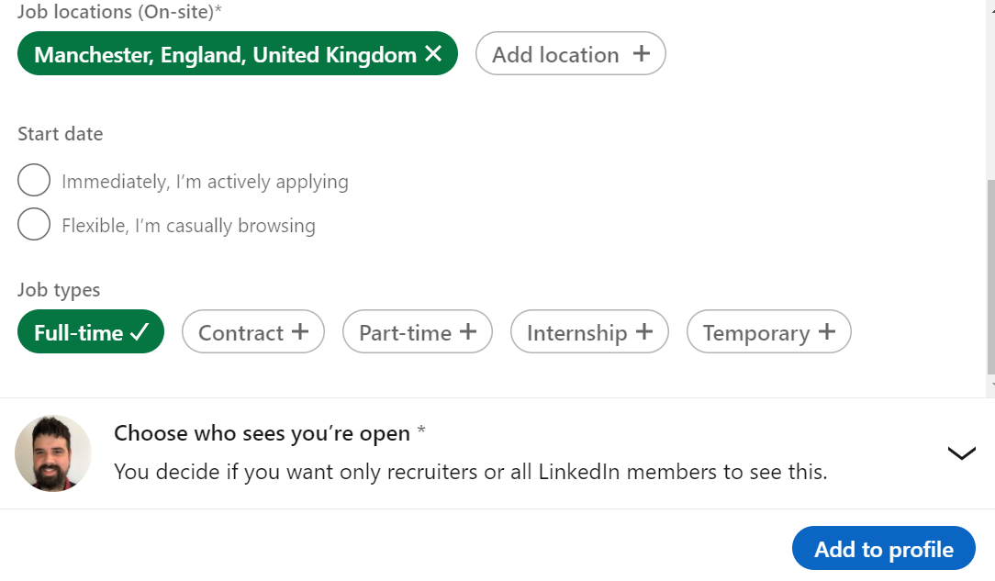
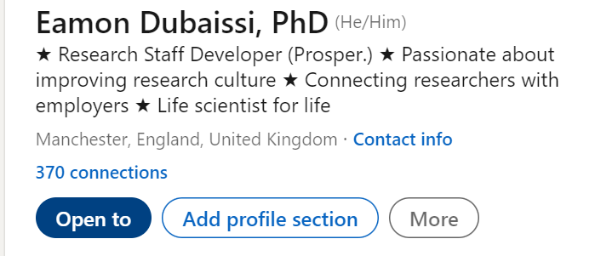
Open to work function
Select ‘Open to’, then ‘Finding a new job’, but be careful. If choose all LinkedIn members then everyone can see it!

Slide 23
Open to work function
When select ‘Share with recruiters only’, recruiters who have paid for access to ‘LinkedIn Recruiter’ can see your profile. But not recruiters at your current organisation
Some employers have a preference for passive candidates. In addition, you may get contacted by people or recruiters you’re not interested in
Other methods can make a bigger impact such as emails, LinkedIn messages and posts

Slide 24
Summary
Take your time to become more comfortable and familiar with LinkedIn
Minimal profile
Listen and lurk
Improve profile
Engage more
Now
Future
Security settings
Privacy settings
Open up

Slide 25
Thank you. Get in touch:
prosper.postdoc@liverpool.ac.uk
https://prosper.liverpool.ac.uk
Twitter: @ProsperPostdoc
Except where otherwise noted, this work is licensed under the Creative Commons Attribution-NonCommercial-ShareAlike 4.0 International License. To view a copy of this license, https://creativecommons.org/licenses/by-nc-sa/4.0/

